Slide 1
Get Storm Ready!
Emergency and Weather preparedness
October 13, 2021

Slide 2
A quick safety moment
A single free call!
5 business days ahead
Electric, gas, water, telecom
Hand digging of 18”+

Slide 3
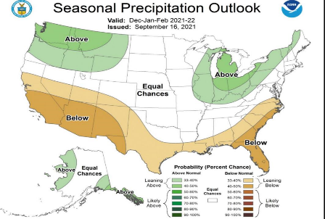
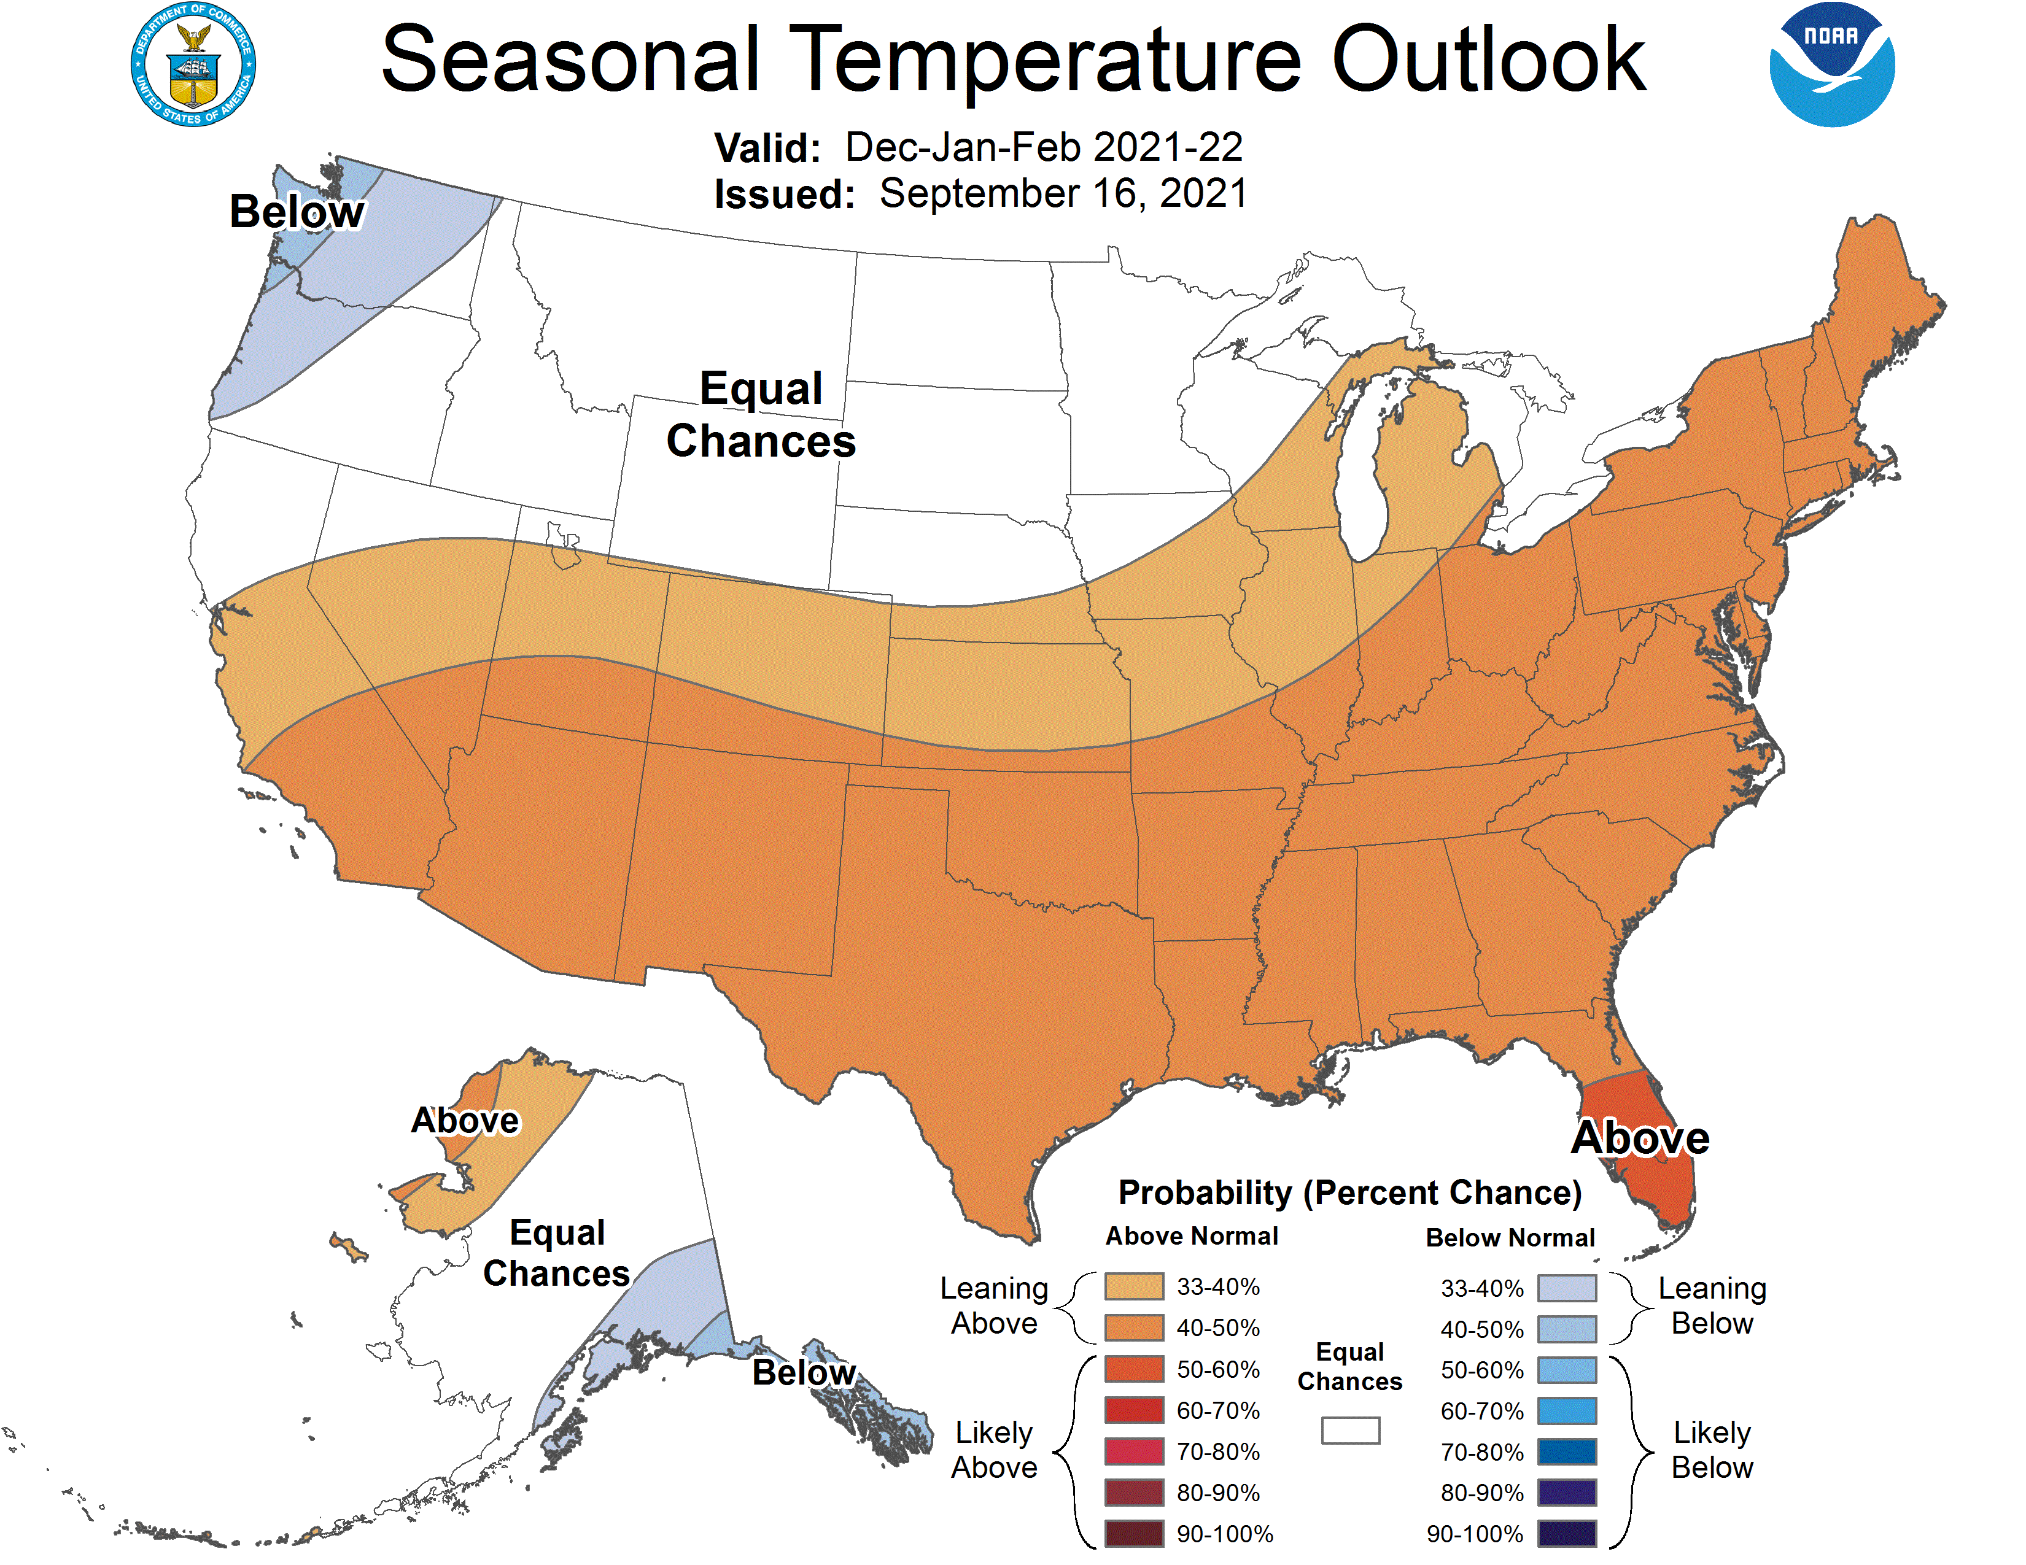
What’s ahead? Latest long-range forecast is in

Slide 4
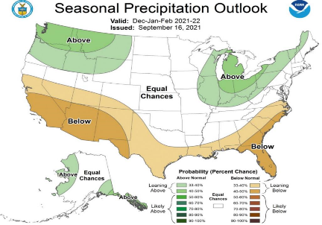
La Nina: A cold ocean sends storms our way
Jet Stream
Steers and energizes storms

Slide 5
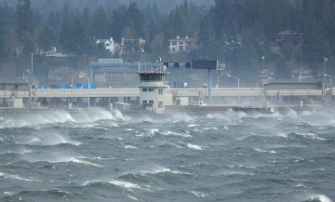
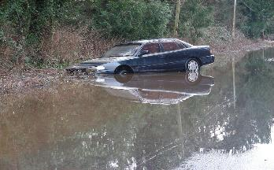
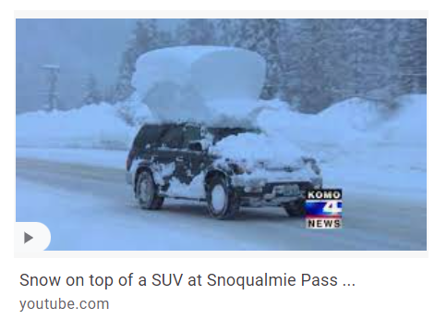
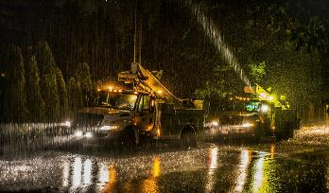
Cool and wet, heavy mountain snow

Slide 6
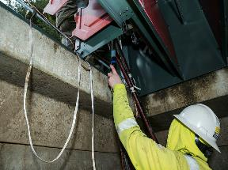
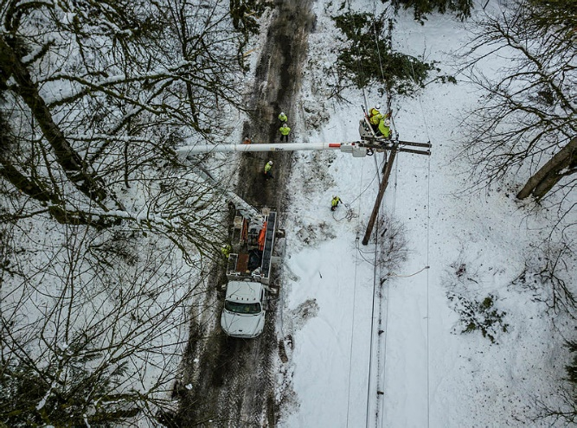
Storm and weather resiliency
Infrastructure
Maintenance
People & planning

Slide 7
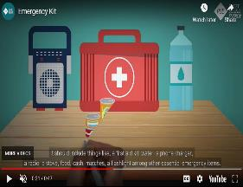
Preparing your family
Infrastructure
Maintenance
People & planning
pse.com
redcross.com

Slide 8
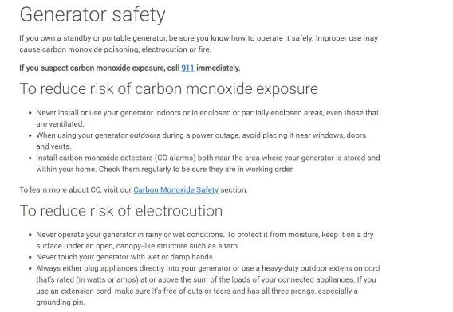
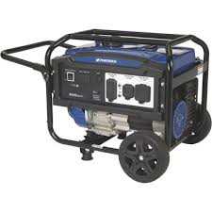
Have a generator? Know what to do!

Slide 9
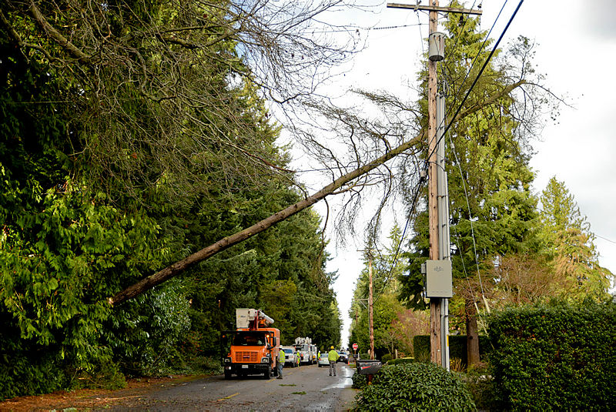
Thank you and stay safe!

