Slide 1
2021 Medina Park Playground IMPROVEMENTS
MaY 10, 2021

Slide 2
Goal of thE Medina Park Playground IMPROVEMENTS
replace older outdated structures and incorporate an Accessible Design that offers a range of play experiences for children of varying abilities

Slide 3
Existing Playground Equipment

Slide 4
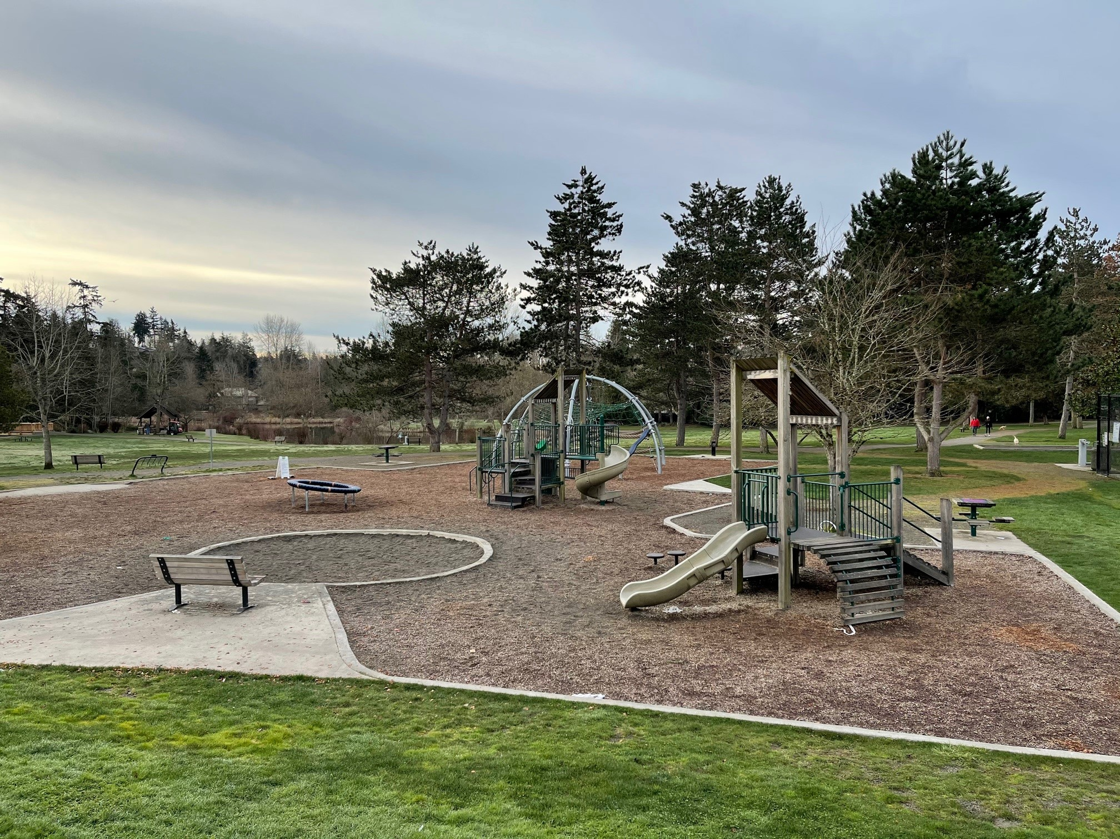

Slide 5
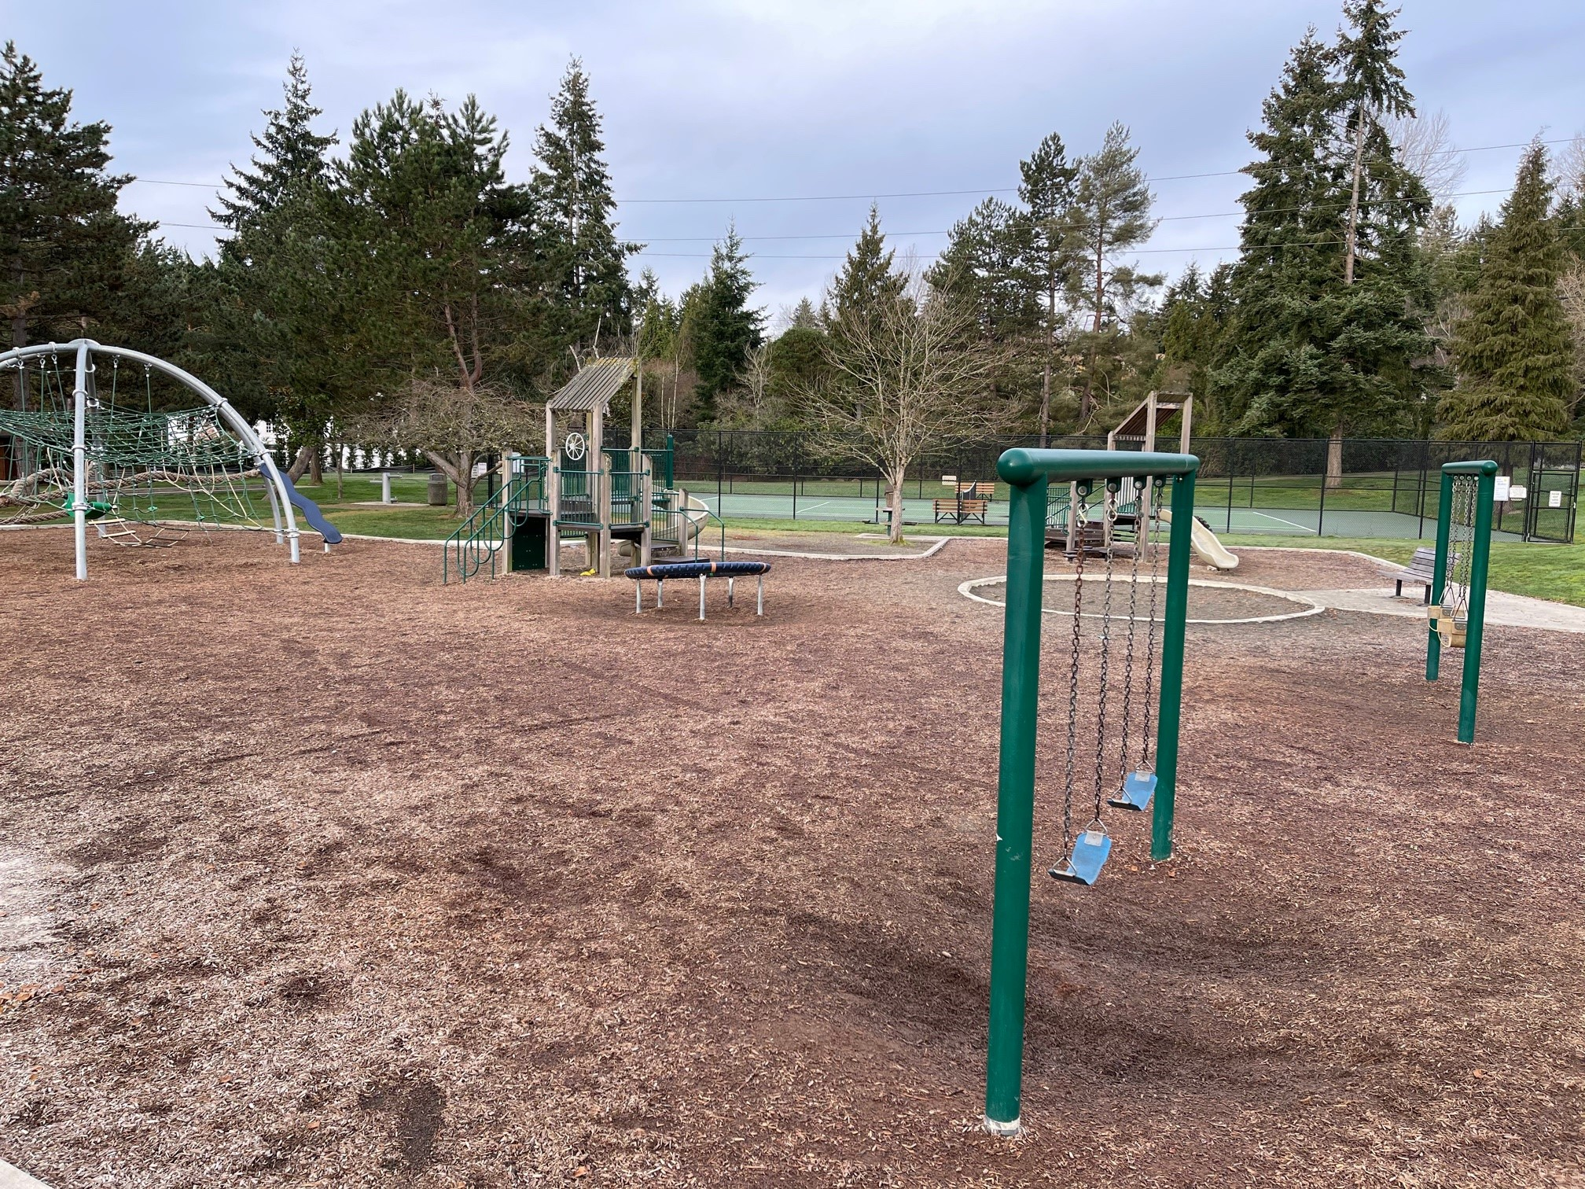

Slide 6
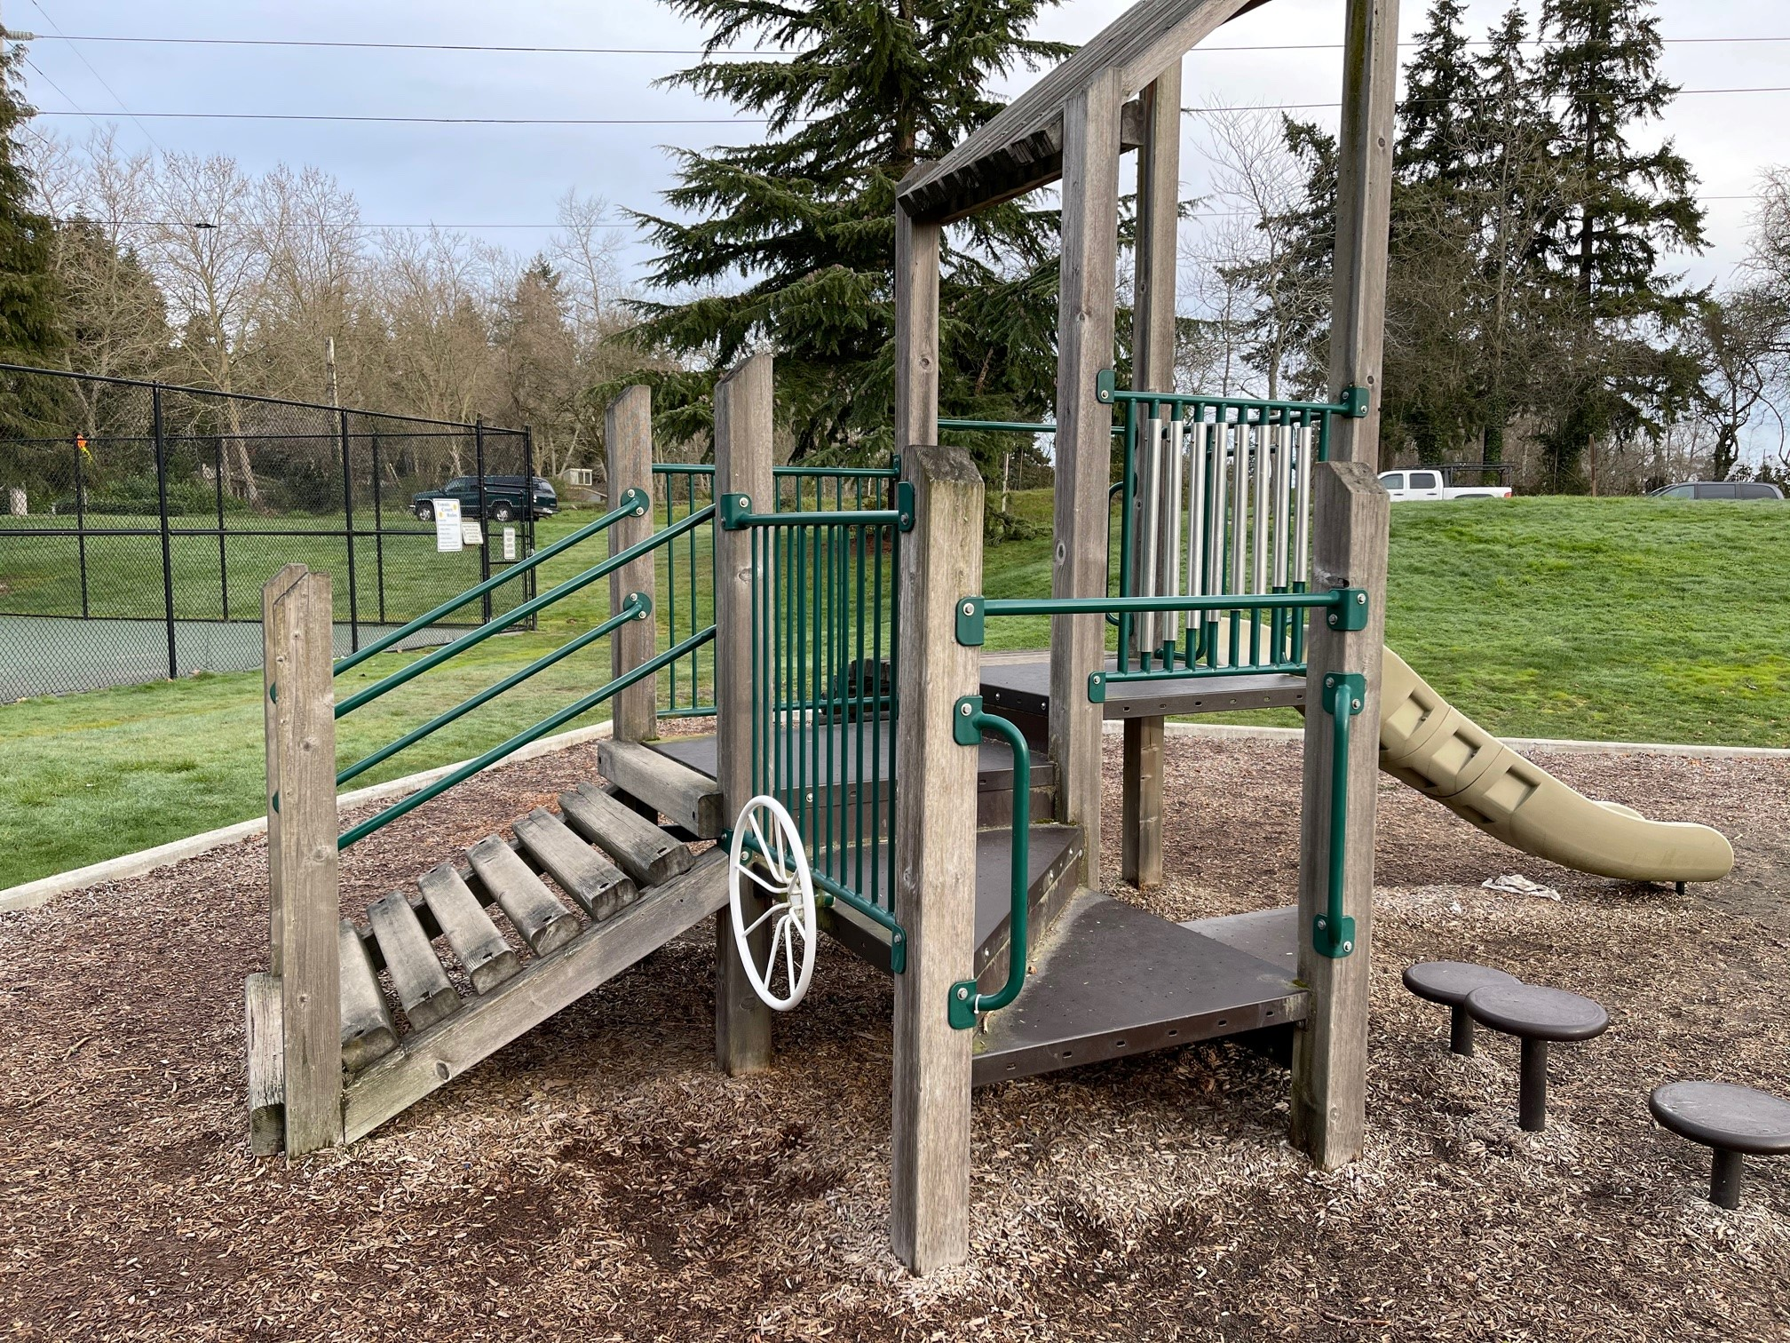

Slide 7
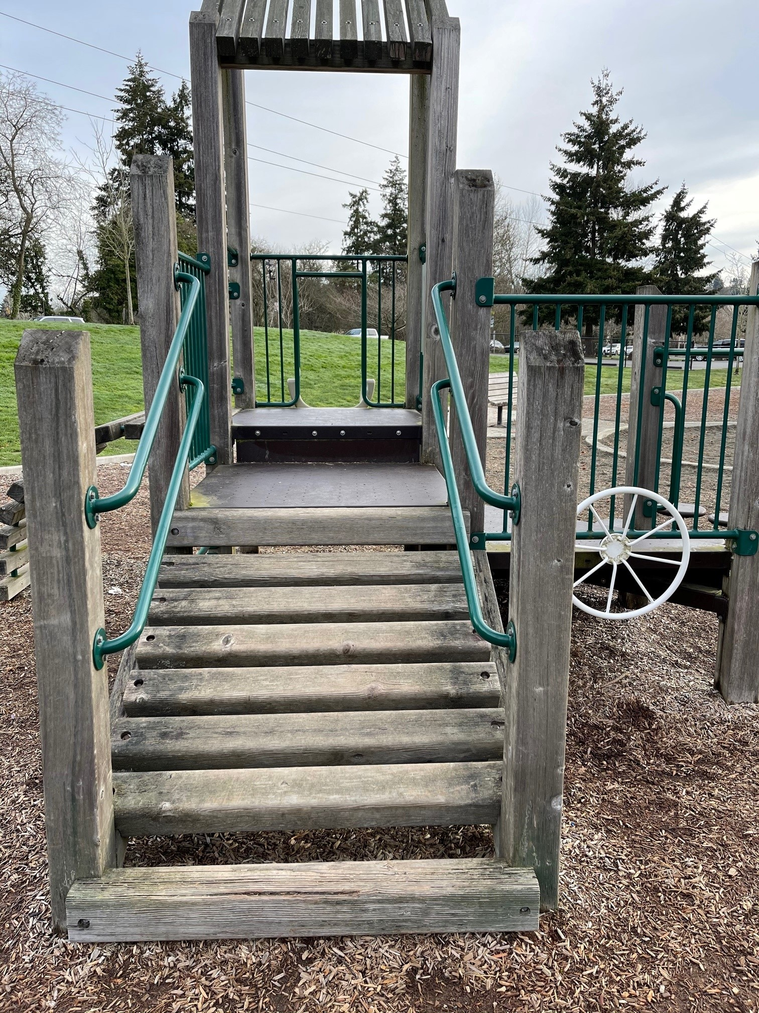

Slide 8
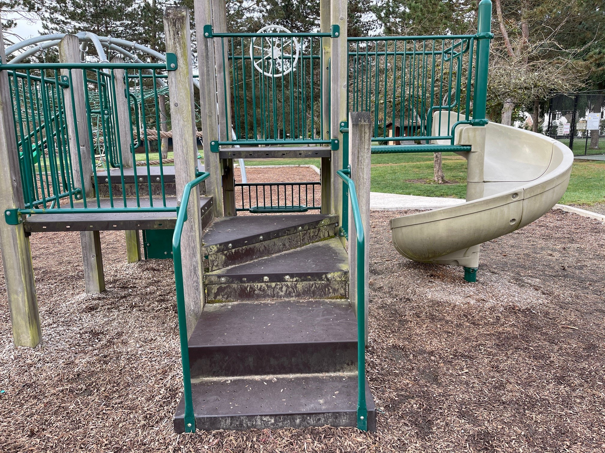

Slide 9
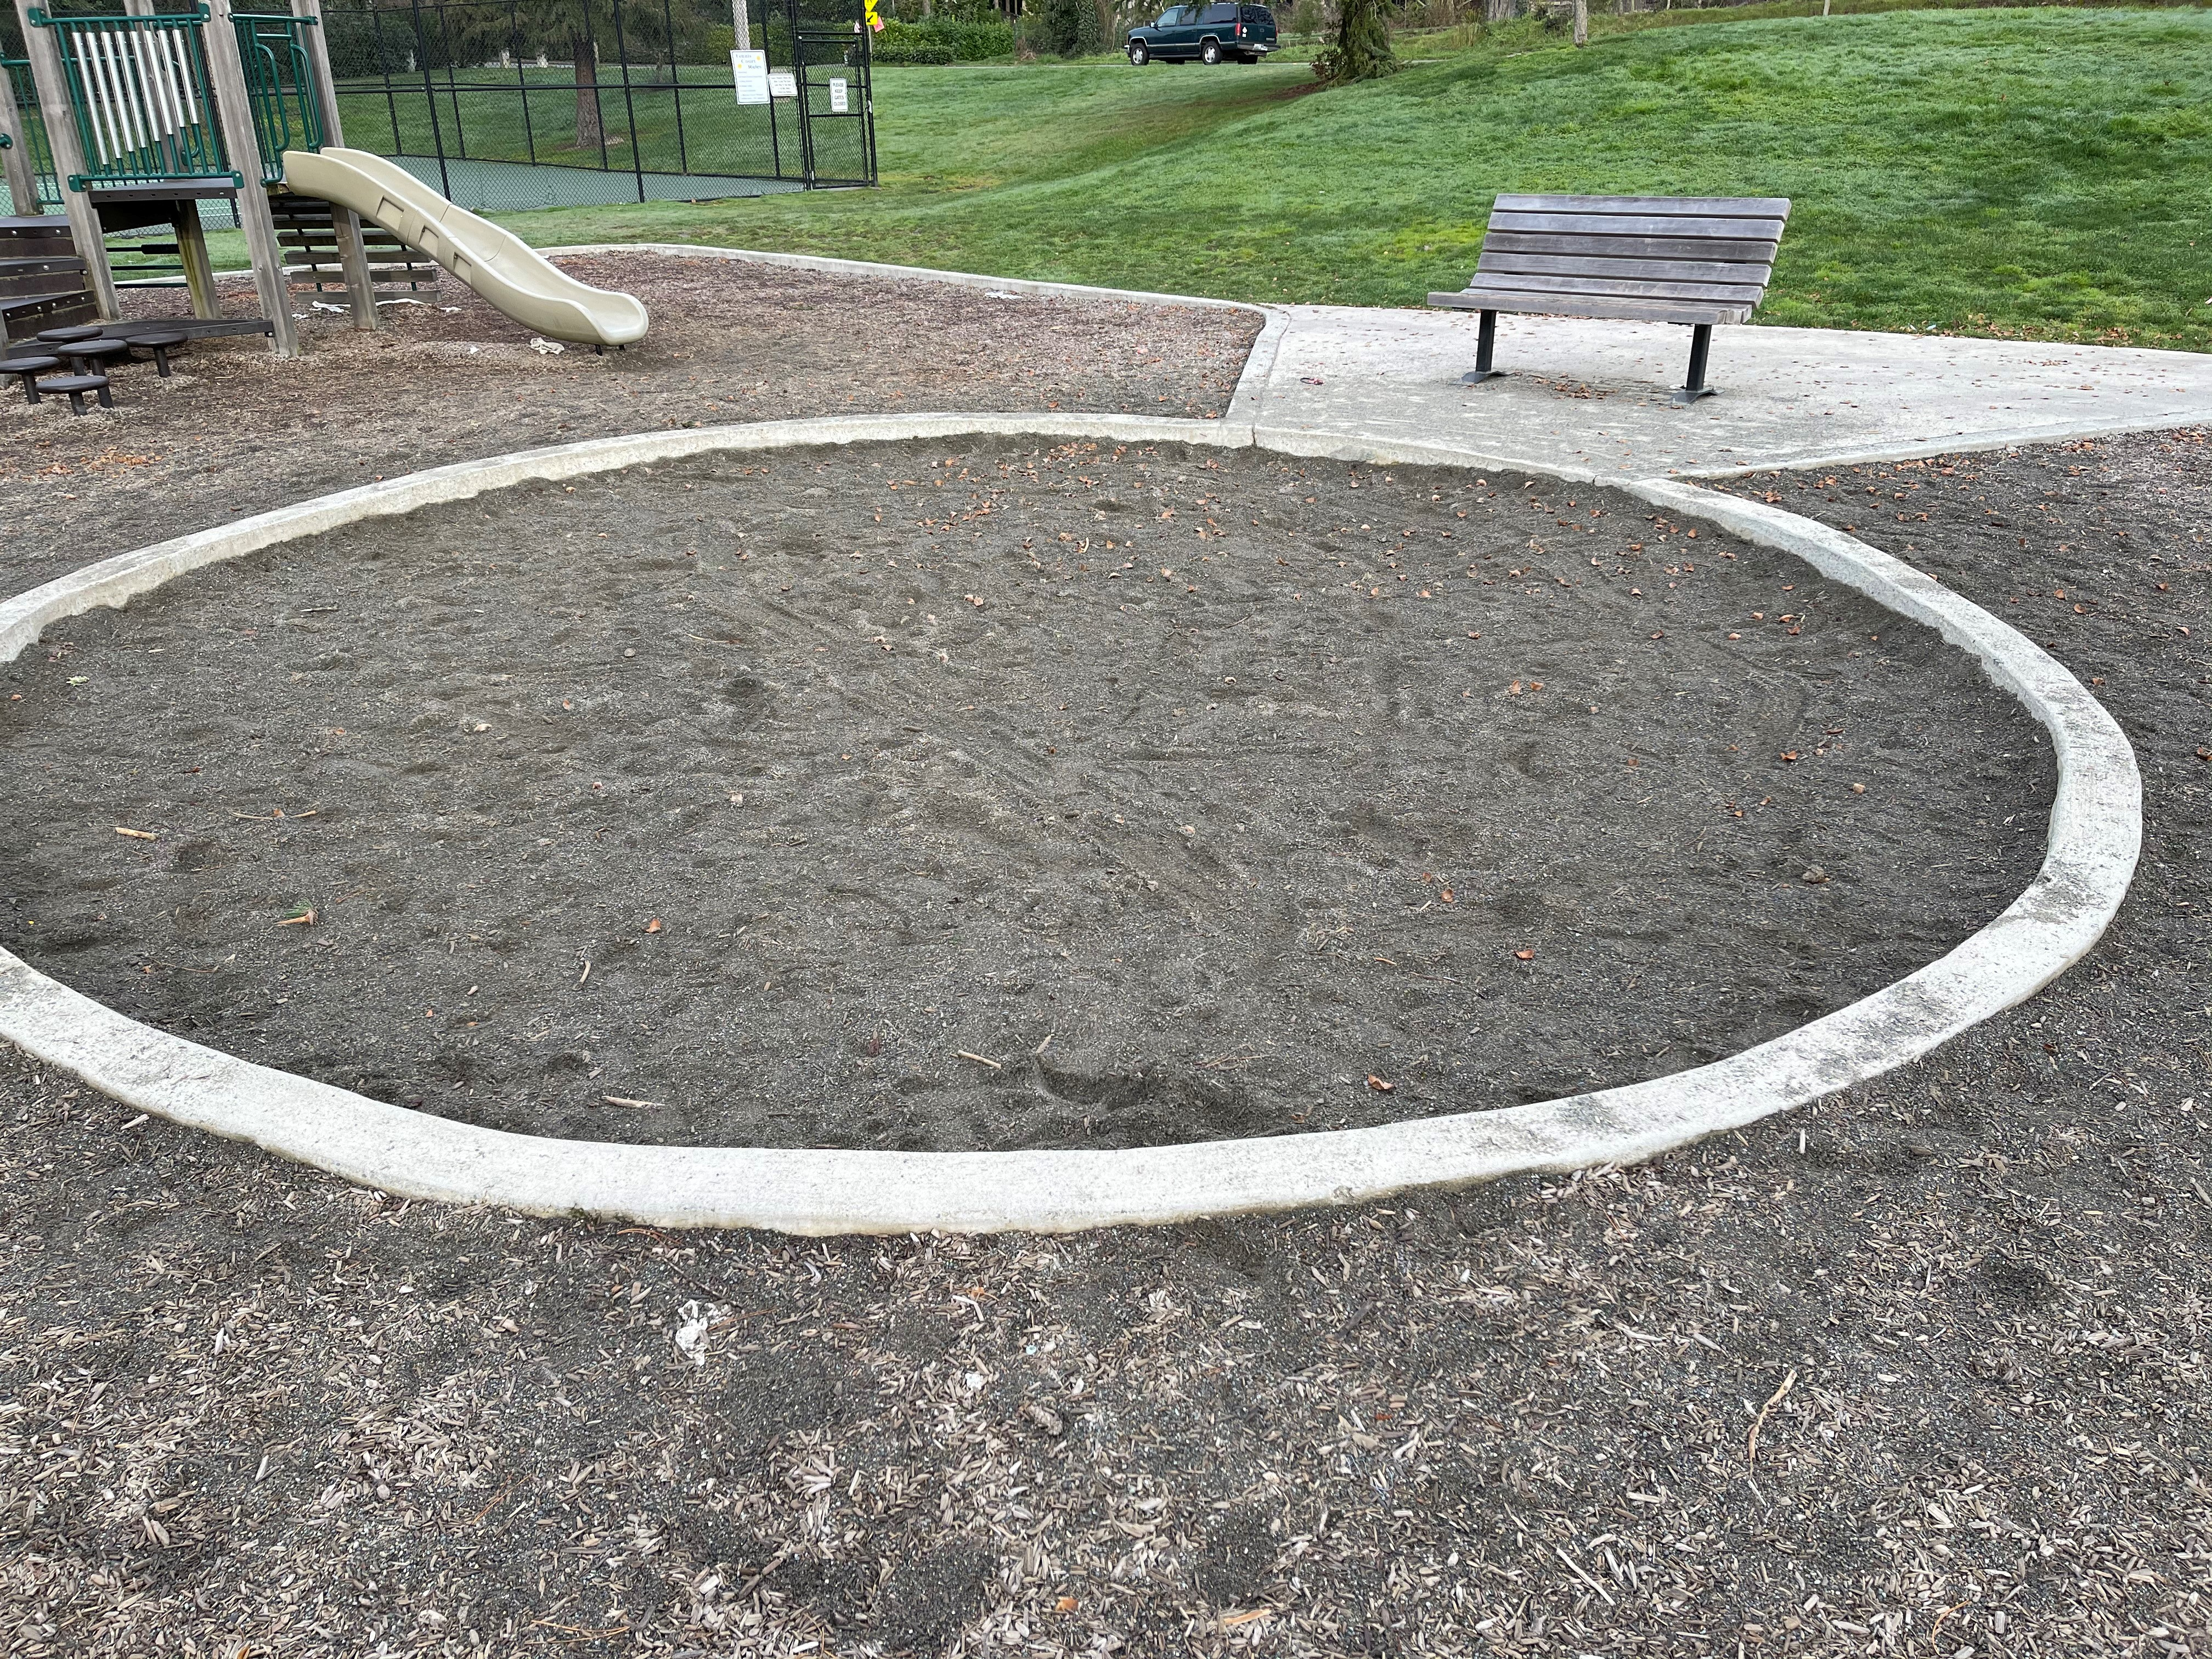

Slide 10
Proposed New Playground Equipment

Slide 26
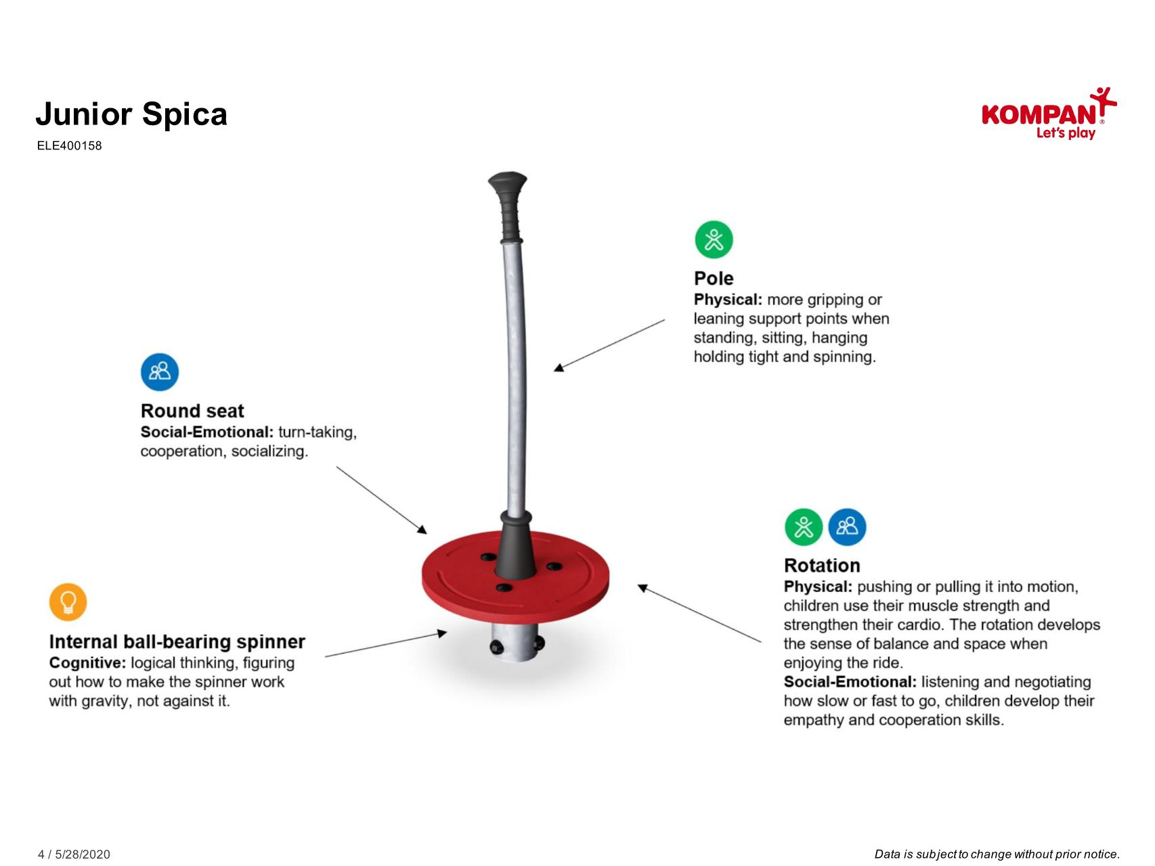

Slide 27
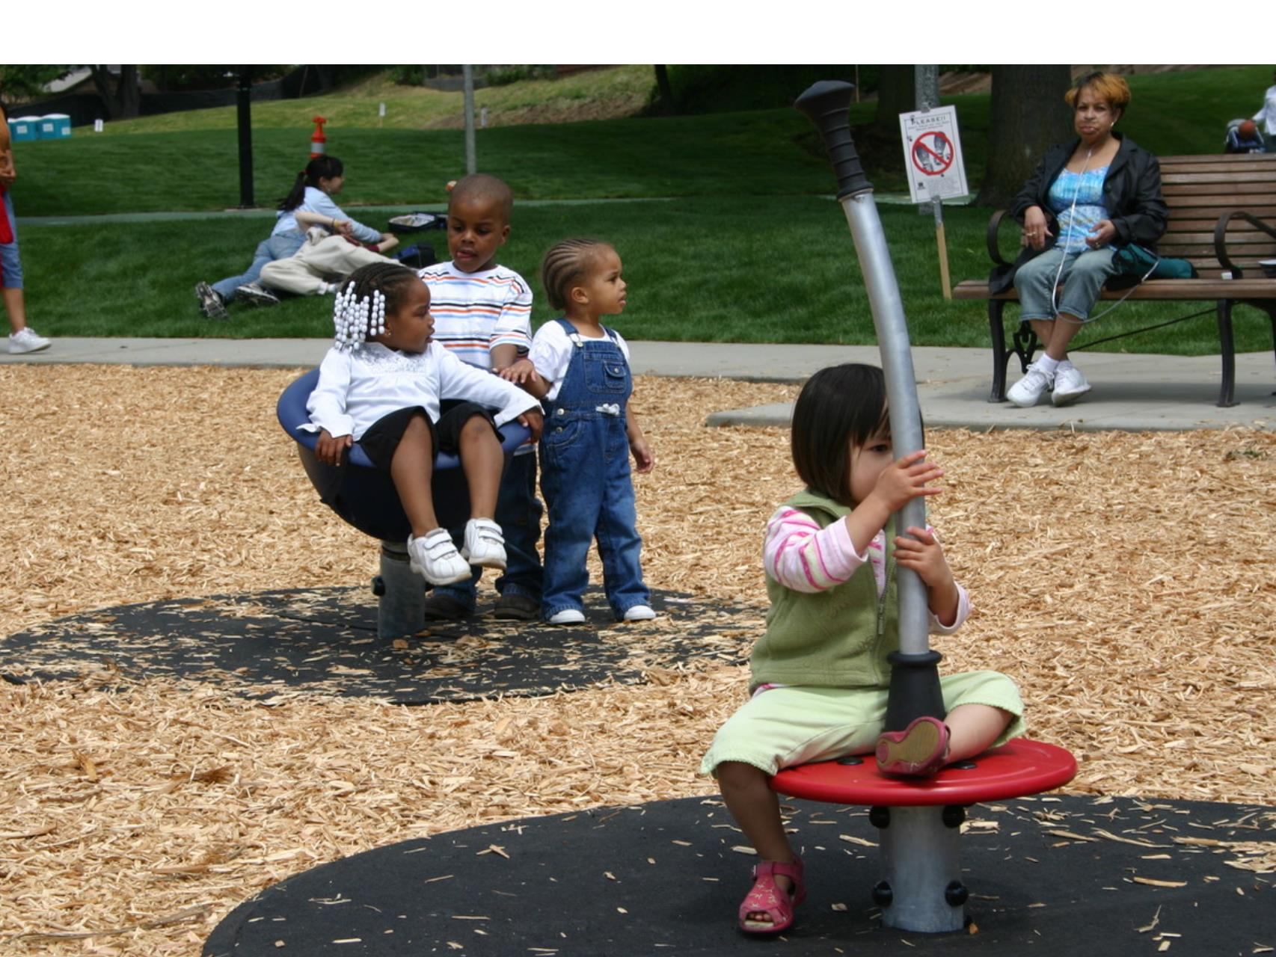

Slide 29
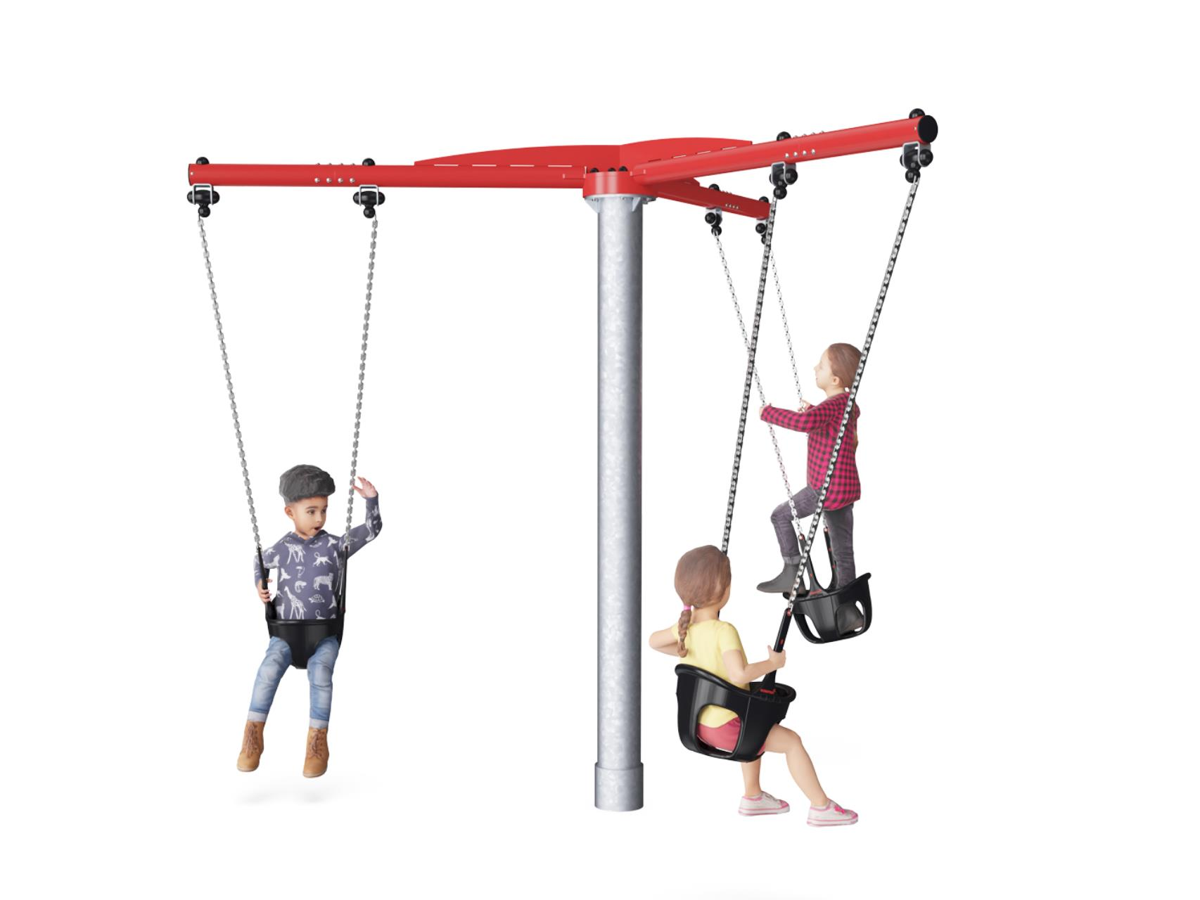

Slide 30
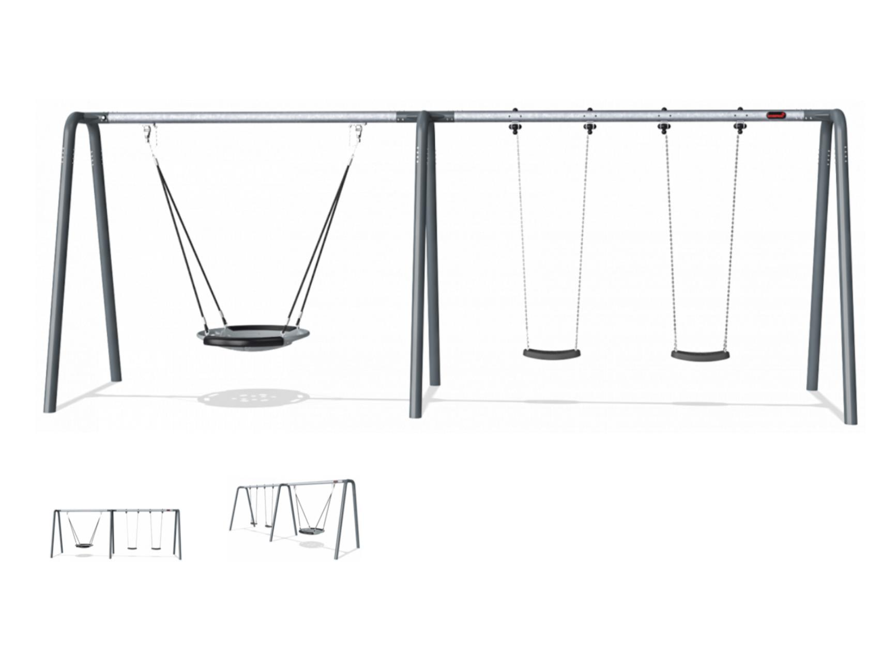

Slide 31
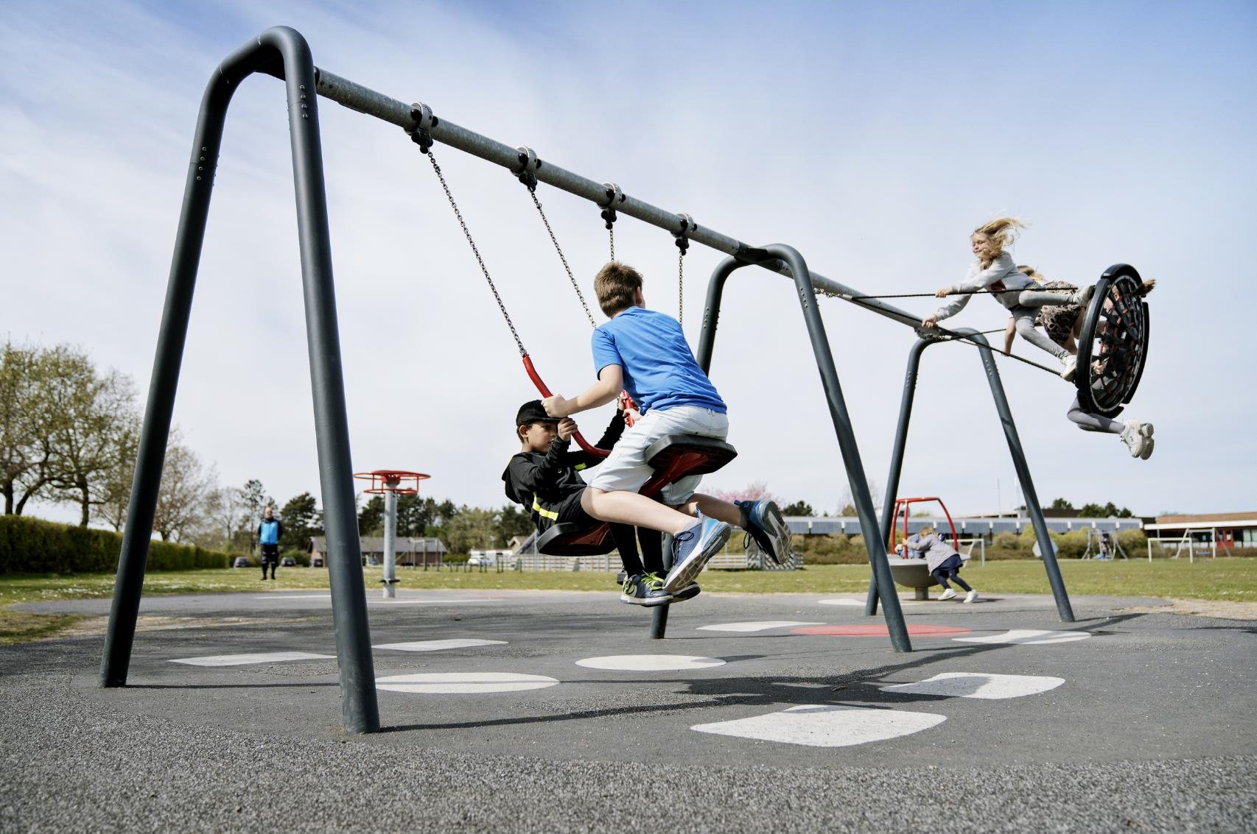

Slide 32
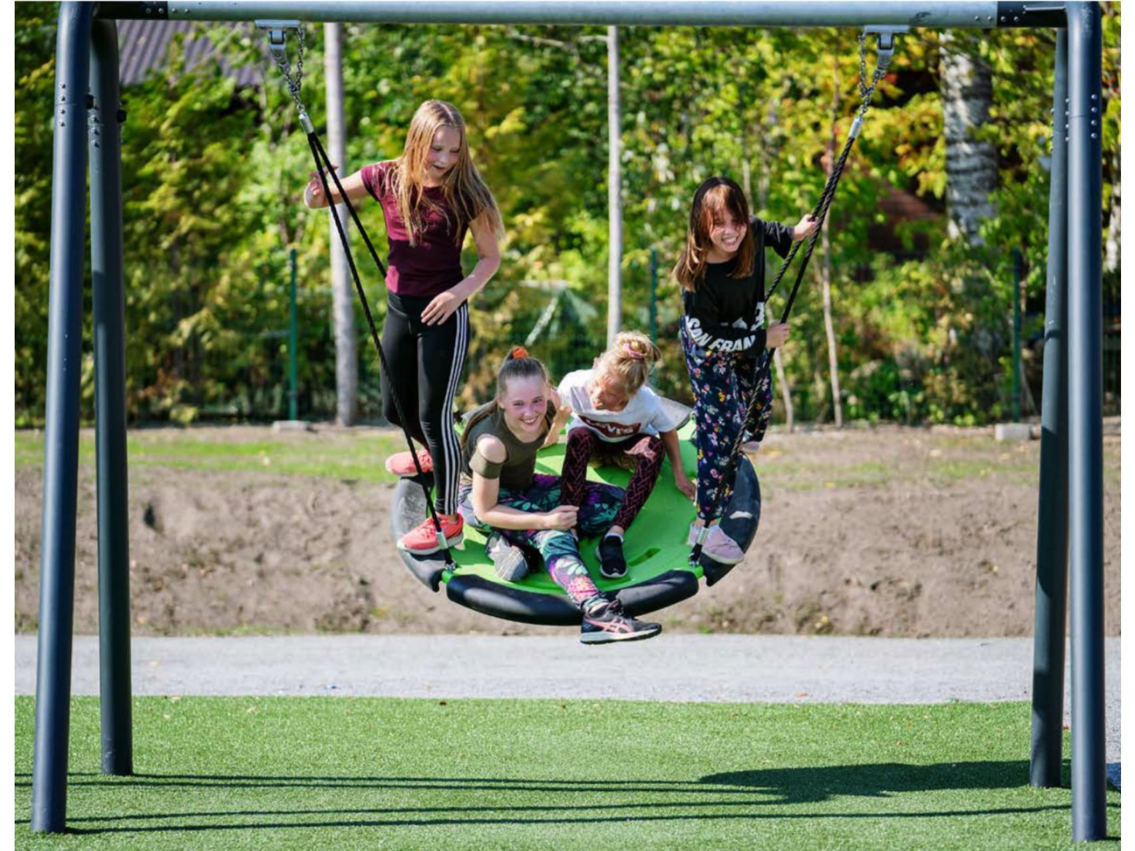

Slide 33
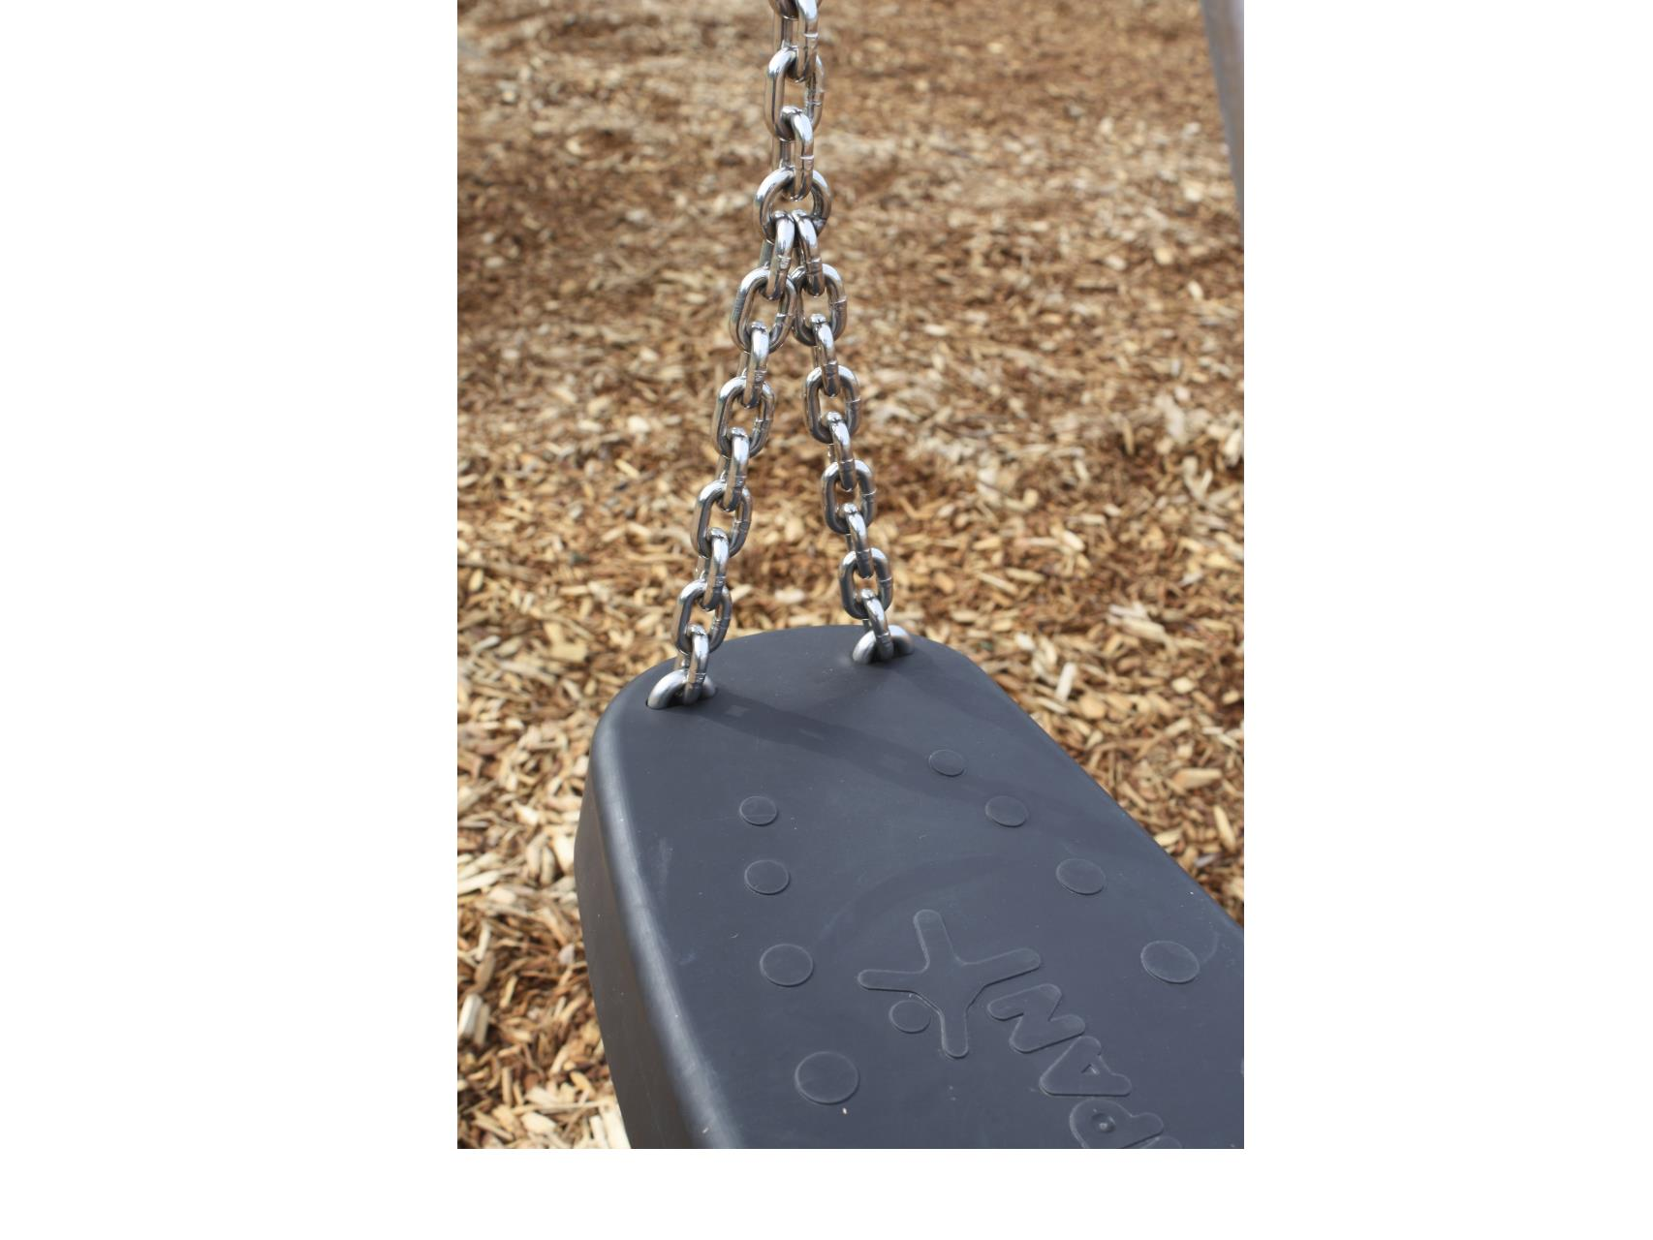

Slide 34
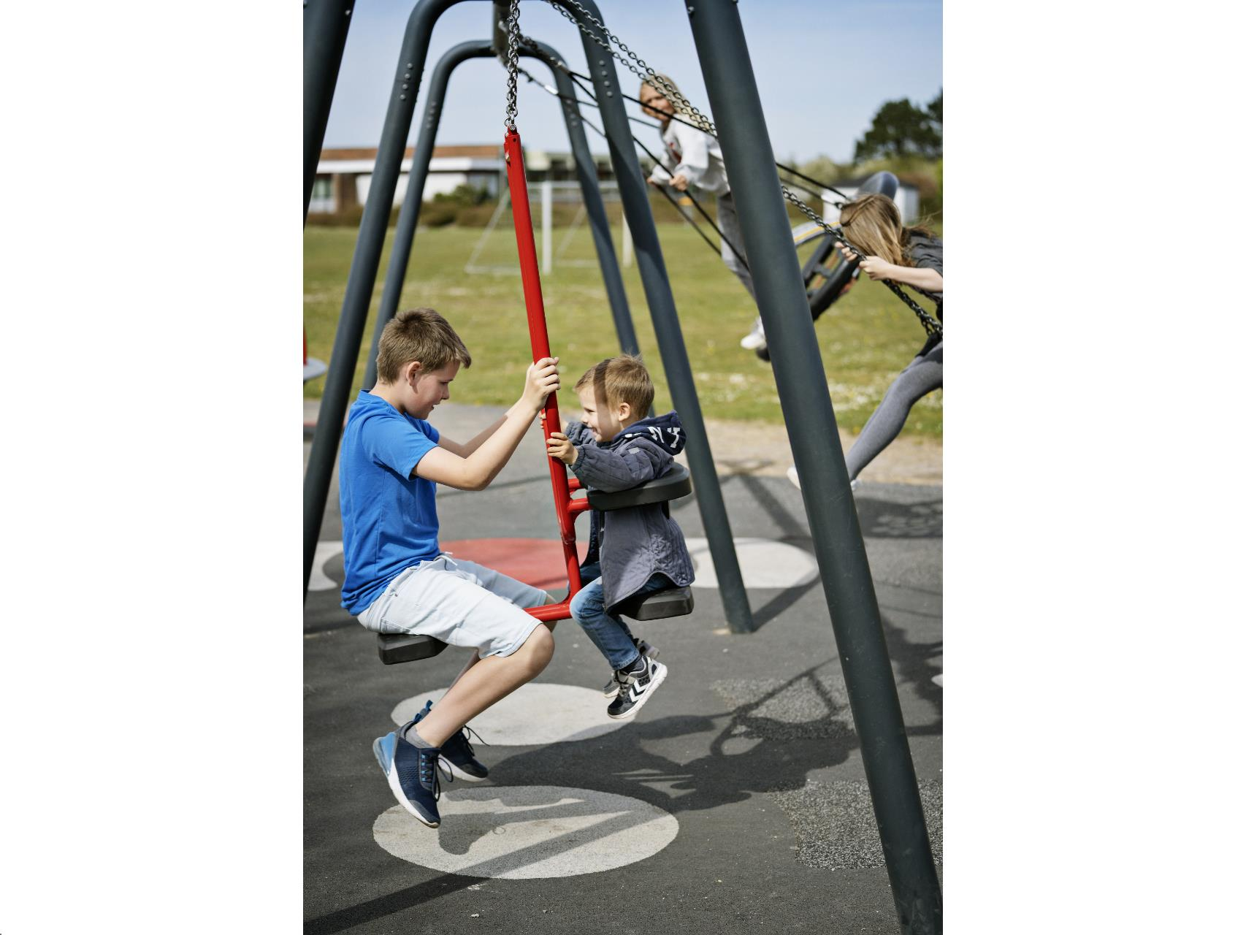

Slide 35
ADOPTED Project Budget
City Capital Funds (REET) $100,000
King County Parks Grant $ 50,000
Total Adopted Budget $150,000

Slide 36
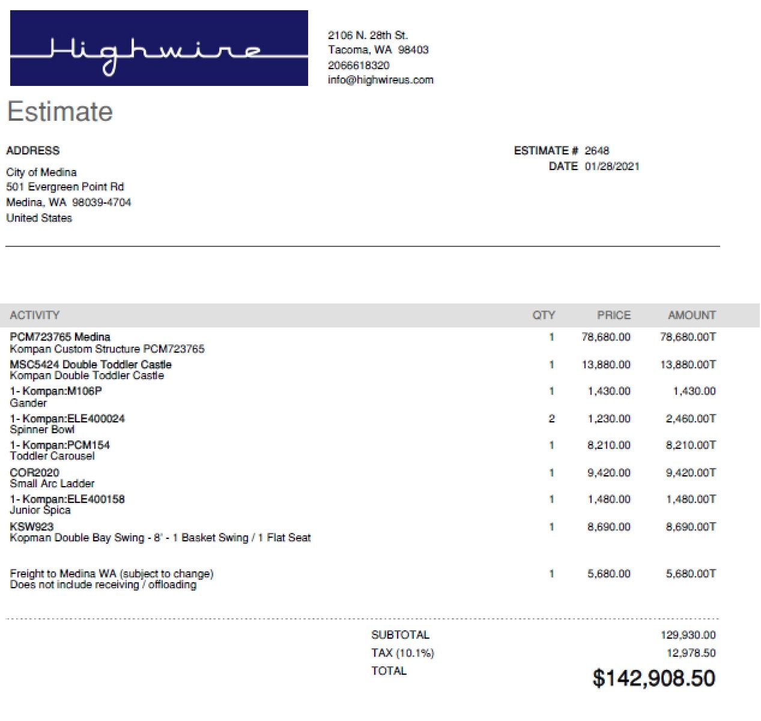

Slide 37
Proposed REVISED Project Budget
City Capital Funds (REET) $100,000 $150,000
King County Parks Grant $ 50,000
Total Adopted Budget $150,000 $200,000
---------------------------------------------------------------------------------------------------------------
Materials and Equipment $150,000
Site Preparation and Installation $ 50,000
Total Project Cost $200,000

Slide 38
Questions???

