Slide 1
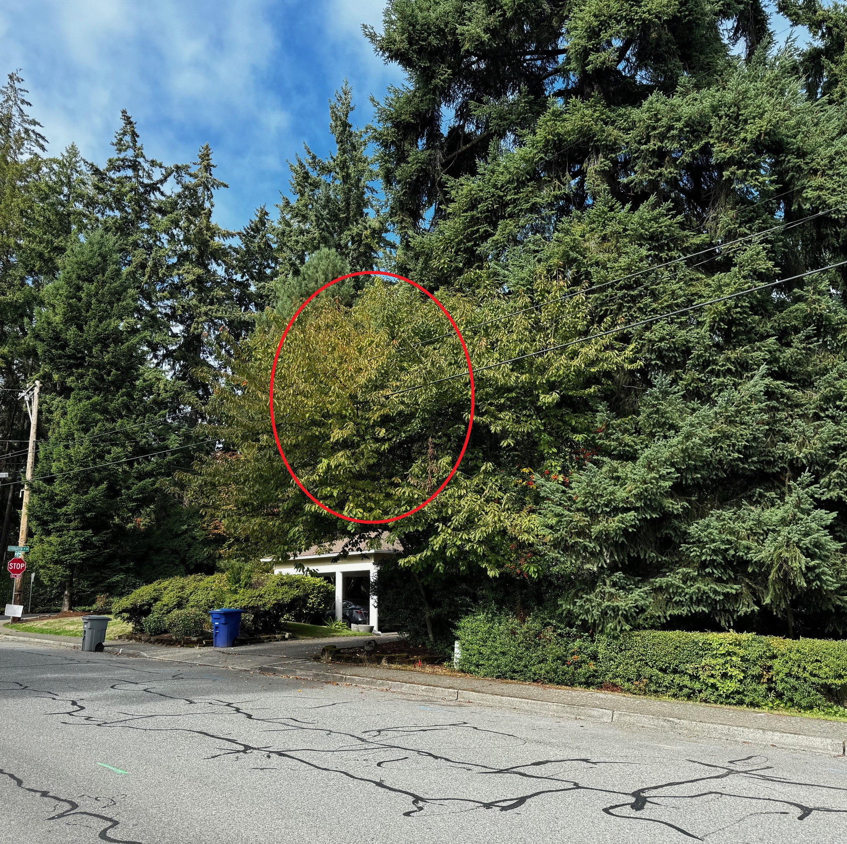
1200 Evergreen Pt Rd
Significantly trim Cherry Tree or removal

Slide 2
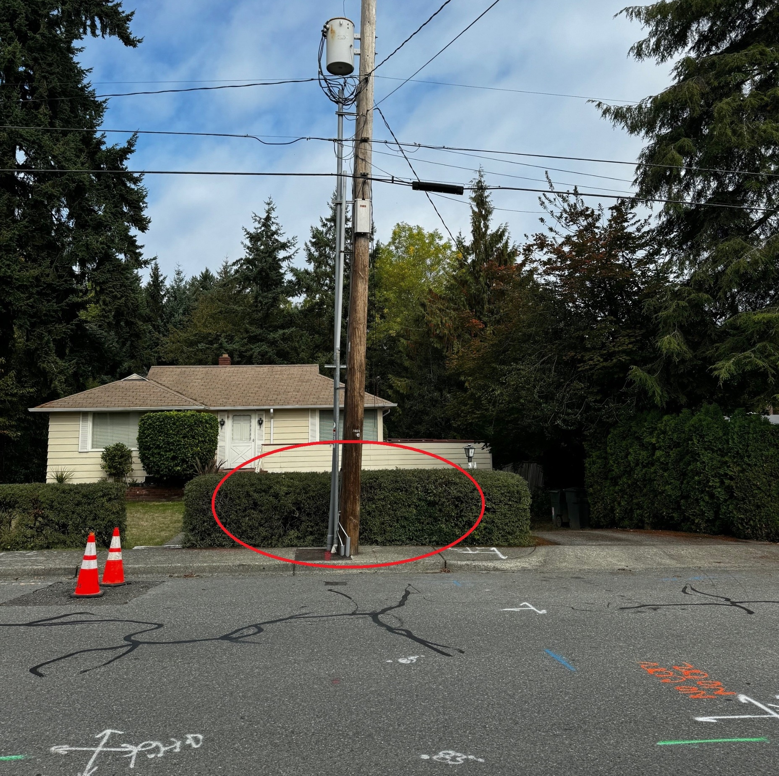
7608 NE 12th ST
Remove hedge

Slide 3
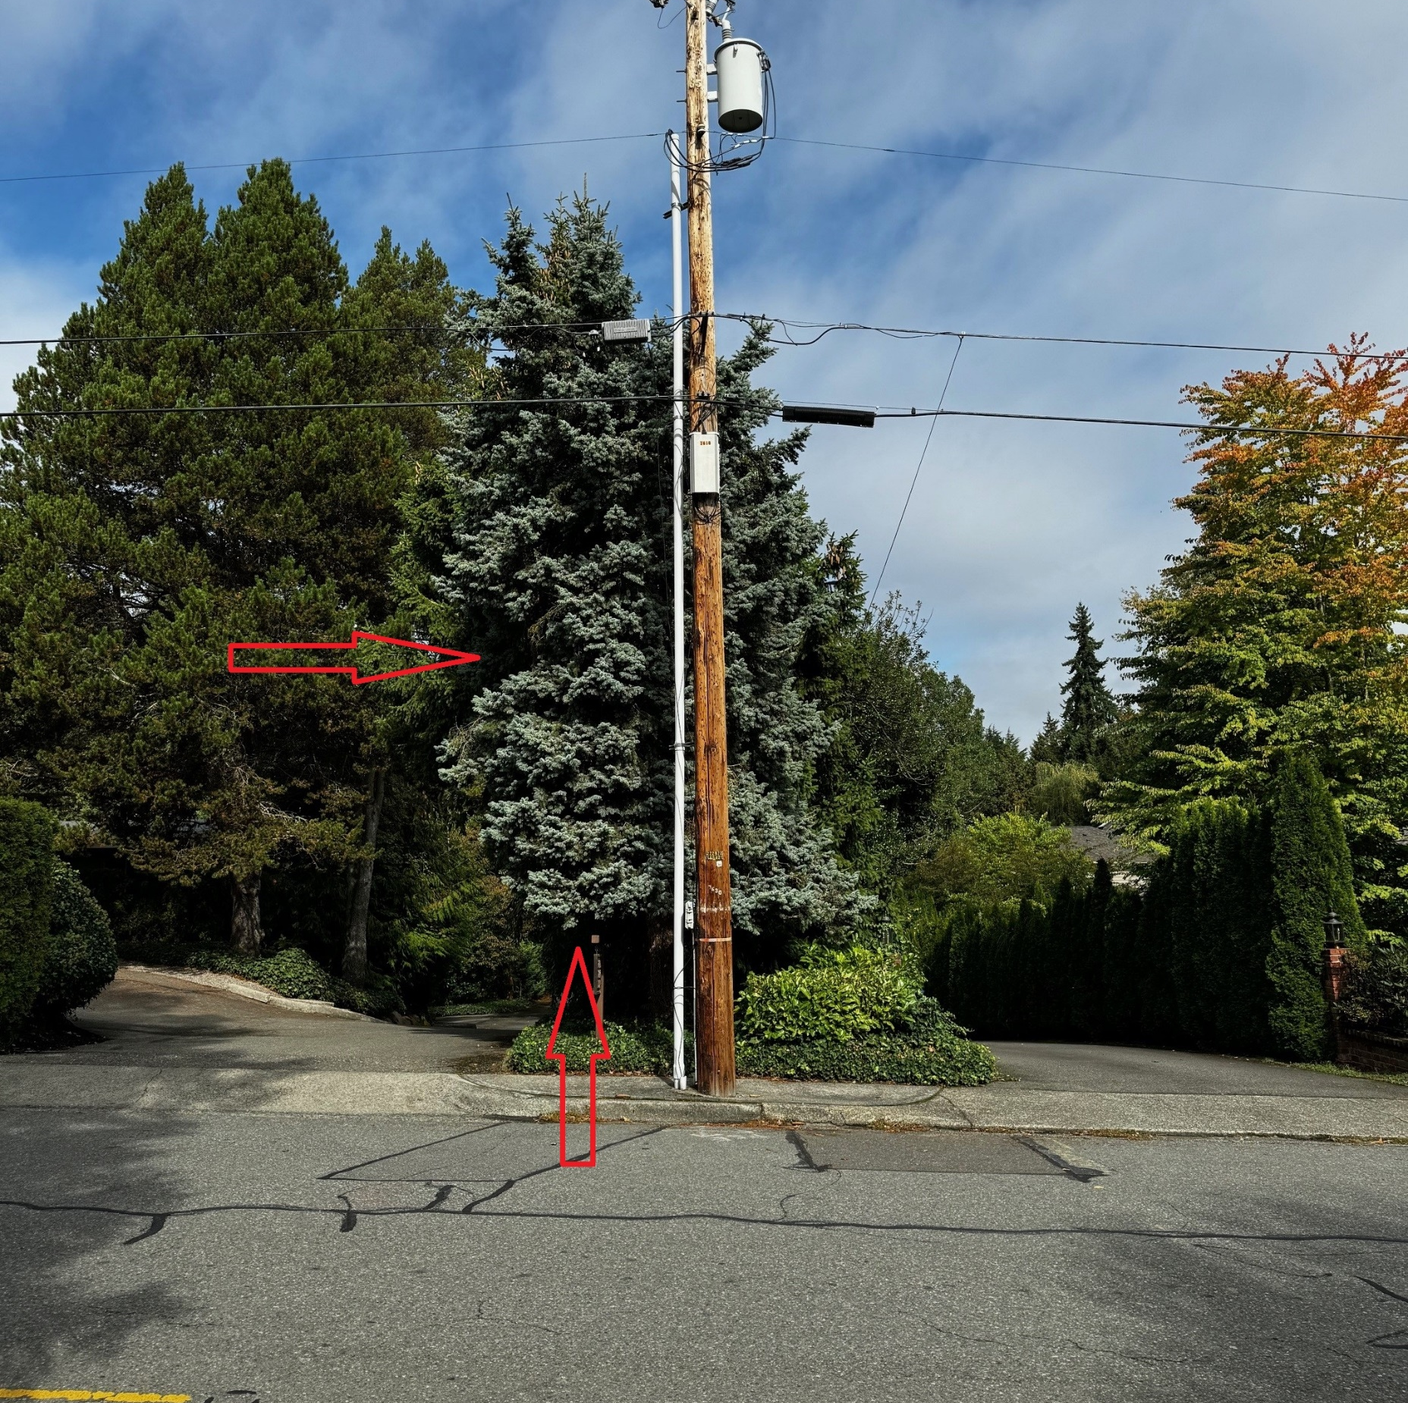
7620/7634 NE 12th ST
Remove tree and ground cover vegetation

Slide 4
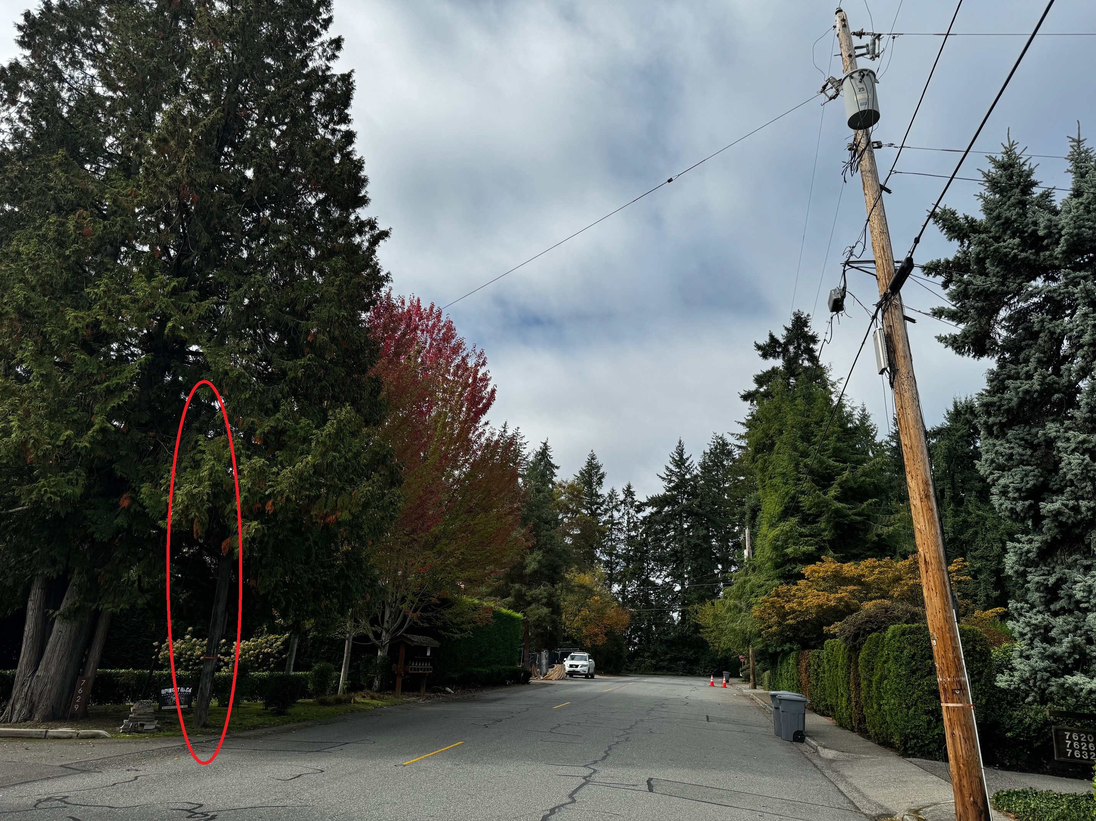
7615 NE 12th ST
Across the street from 7620/7634, delete tensioner pole

Slide 5
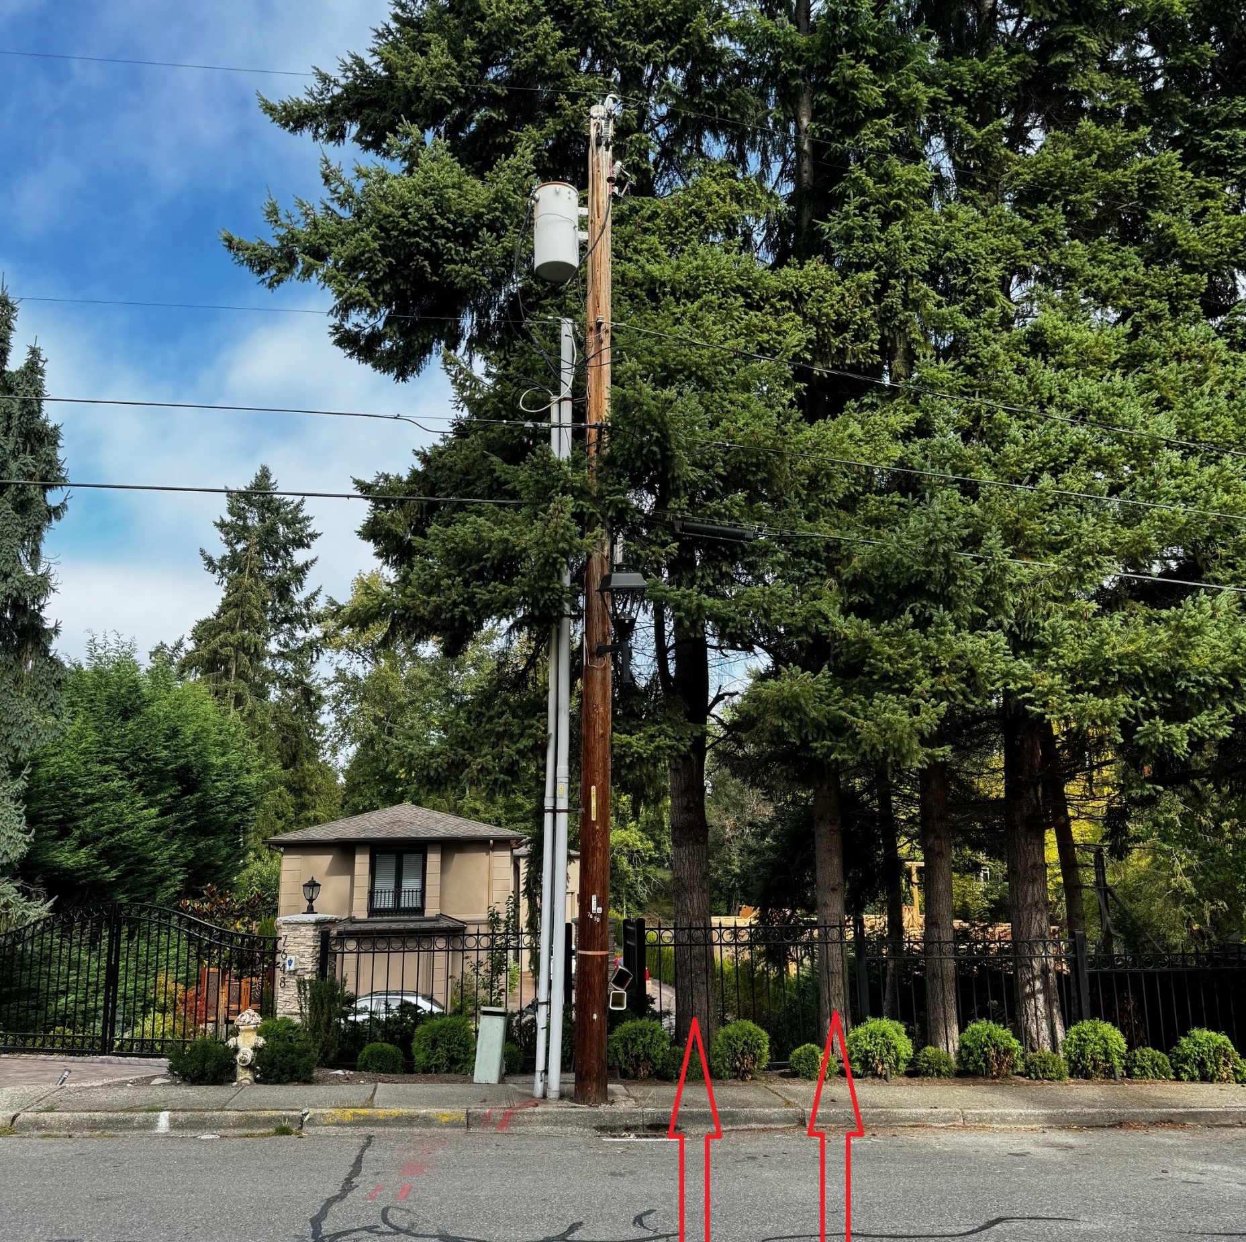
7648 NE 12th ST
Remove two trees. Existing fence is in the ROW. Notice of violation has been sent.

Slide 6
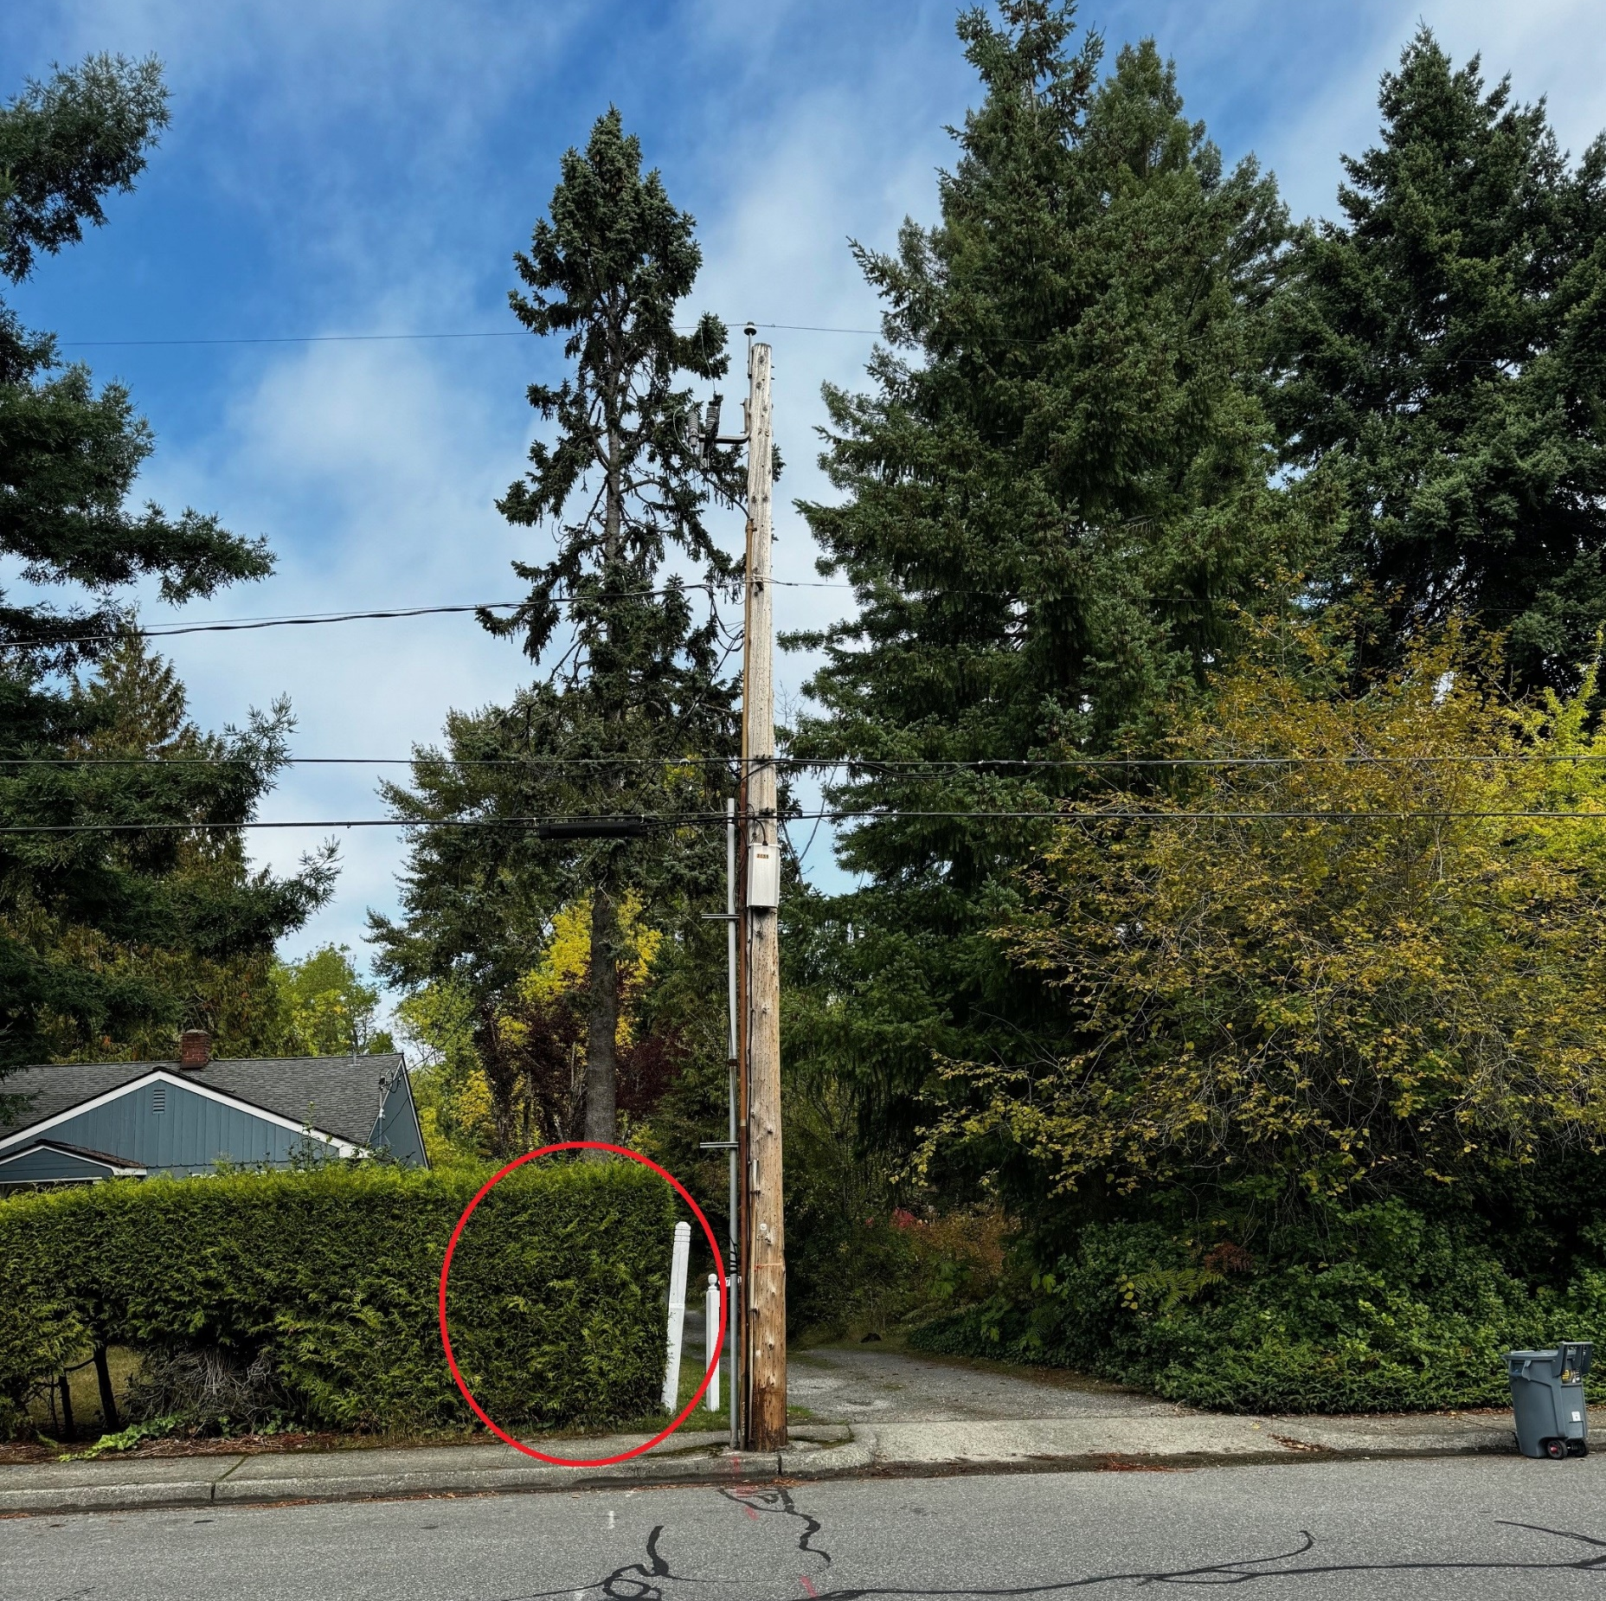
7658/7804 NE 12th ST
Remove portion of hedge and section of white fence in the ROW

Slide 7
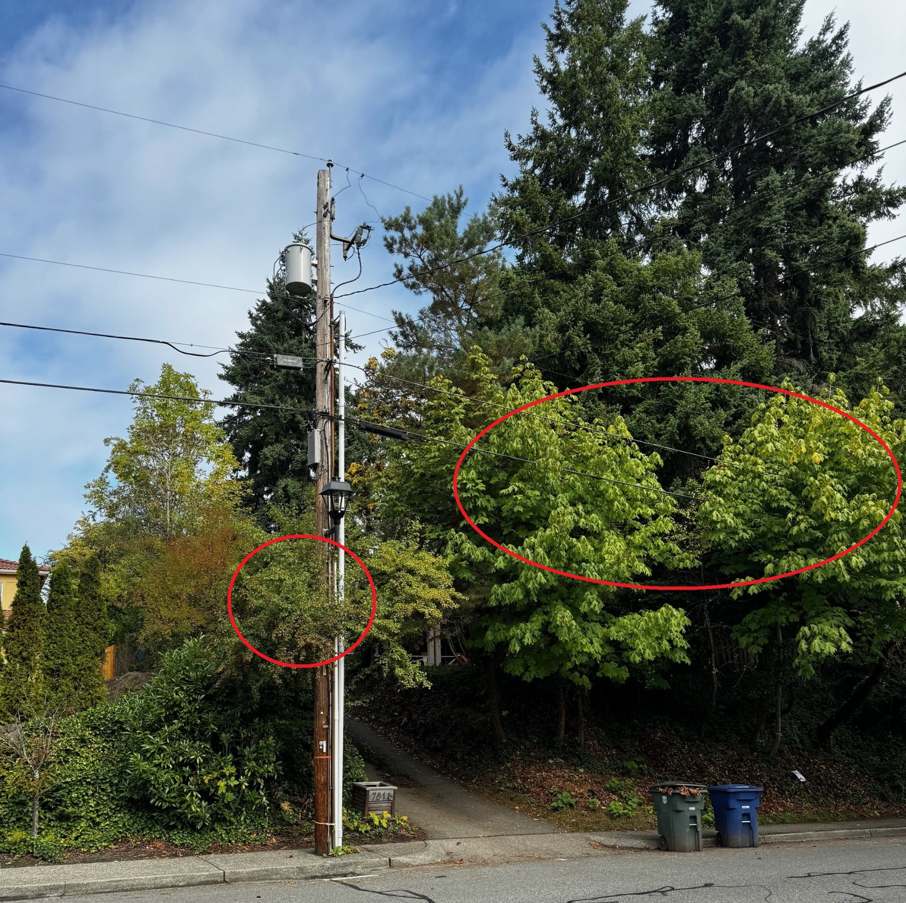
7808/7816 NE 12th ST
Trim tree behind pole and along frontage
7816 is being redeveloped, possibly removing frontage trees.

Slide 8
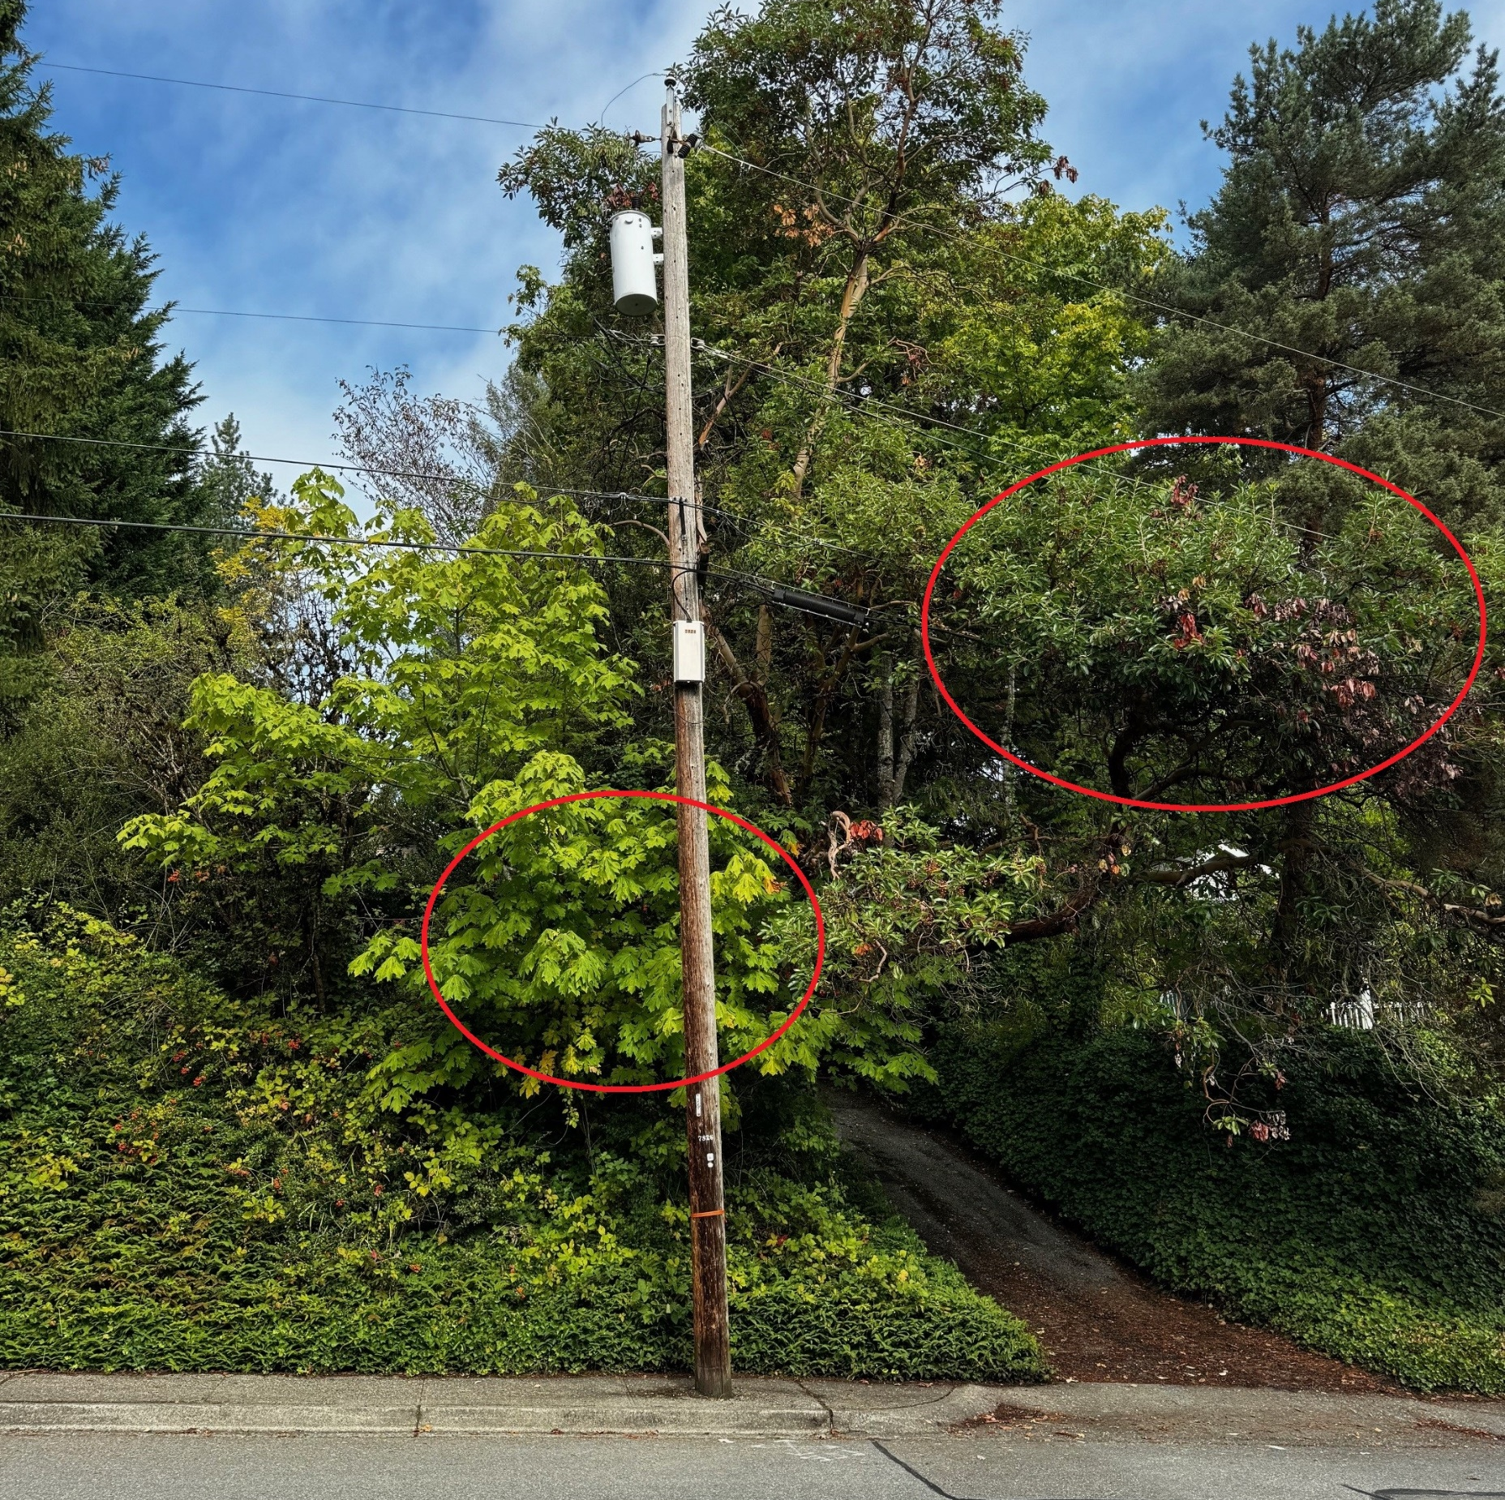
7826/7830 NE 12th ST
Trim maple behind pole and trim along frontage

